Slide 1
CSWE’s Exhibitor University
Recorded Tuesday, May 14, 2019

Slide 2
WELCOME
We are recording
Please mute your microphone
Questions can be entered in chat

Slide 3
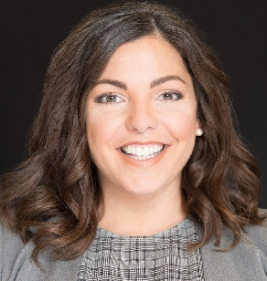
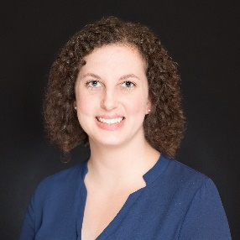
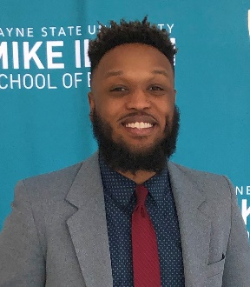
CSWE Staff Introductions
Julie Montross, Vice President, Communications & Marketing
Allison Moon, Communications & Marketing Manager
Malcolm Randall, Communications & Marketing Coordinator

Slide 4
Freeman Staff Introduction
Brian Cate, Director, Client Solutions, Freeman

Slide 5
Agenda
Overview of APM
Pre-APM activities
On-site timeline and activities
Etiquette
Marketing opportunities
Key contacts
Important deadlines
Questions?

Slide 6
Overview of APM
Denver, CO.
Sheraton Denver Downtown
October 24 through 27
130+ exhibitors
2600+ participants

Slide 8
Pre-APM Activities
Encourage all exhibit personnel to watch webinar
Planning for personnel for set-up and teardown
Comp passes
Housing and registration
Exhibitor Service Kit and Freeman Online
Promotion
@CSocialWorkEd #APM19 #SocWorkEd

Slide 10
On-site timeline and activities
Set-up hours October 24, 10am until 3pm
Exhibit floor access during set-up
Opening reception - exhibitor early-access
Exhibit Floor Hours
5. Tear down
October 27, not earlier than 12 Noon ($500 penalty for striking booth early)

Slide 11
Etiquette

Slide 12
Marketing Opportunities
Marketing Prospectus

Slide 13
Marketing Opportunities

Slide 14
Marketing Opportunities

Slide 15
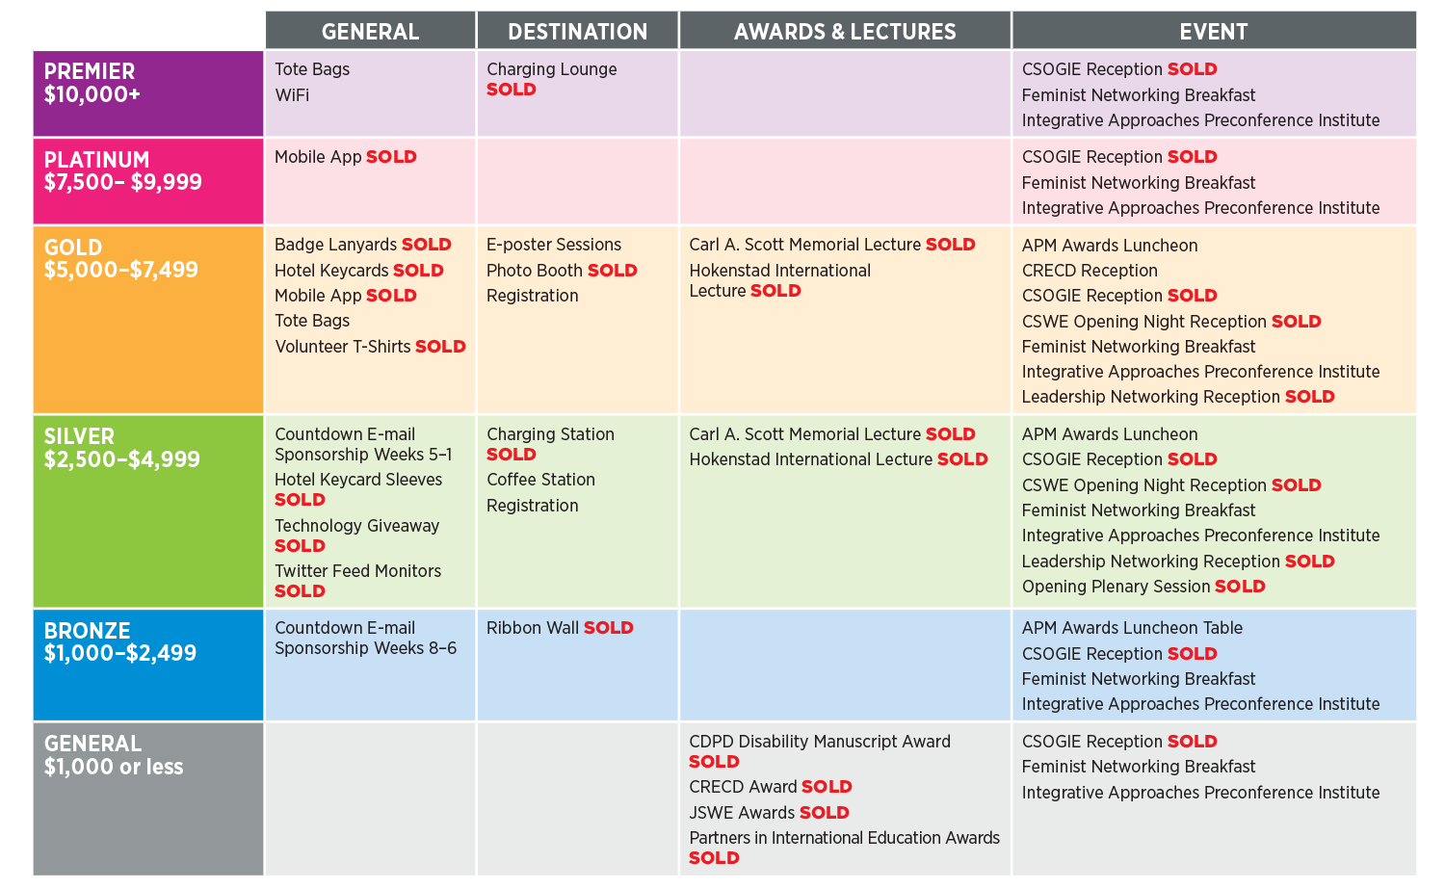
Marketing Opportunities

Slide 16
Key Contacts
Malcolm Randall, Communications & Marketing Coordinator
mrandall@cswe.org
Ad sales and artwork submissions
Booth descriptions
Allison Moon, Communications & Marketing Manager
amoon@cswe.org
Sponsorship sales
Julie Montross, Vice President, Communications & Marketing
jmontross@cswe.org
Exhibit sales

Slide 17
Key Contacts
Exhibitor Services
Audio/Visual/Electric

Slide 18
Important Deadlines
Booth description deadline: August 20
Final Program ad reservation deadline: August 13
Final Program ad artwork submission deadline: August 20
Sponsorship deadline: August 26
Discount deadline for Freeman: October 1
Freeman advanced freight deadline: October 18

Slide 19
Floorplan

Slide 20
Reserve Your Booth Here!

Slide 21
QUESTIONS?

