Slide 1
Implementing Integrated Behavioral Healthcare
Module 7
Victoria Stanhope, PhD
New York University

Slide 2
Module Objectives
To provide an overview of the multi-level change that accompanies primary and behavioral healthcare integration
To describe the different roles and functions of providers involved in integrating care and identify the role of social workers
To delineate the barriers and facilitators to implementing primary and behavioral healthcare integration
To understand how to evaluate the implementation and effectiveness of primary and behavioral healthcare integration

Slide 3
What does IBH Look Like?
Integrating Mental Health into Primary Care
IMPACT – Evidence Based Depression Care
TEAMcare

Slide 4
Adopting IBH
Requires multi-level change:
Systems Level
Organizational Level
Provider Level
Provider-Consumer Relationships
Consumer

Slide 5
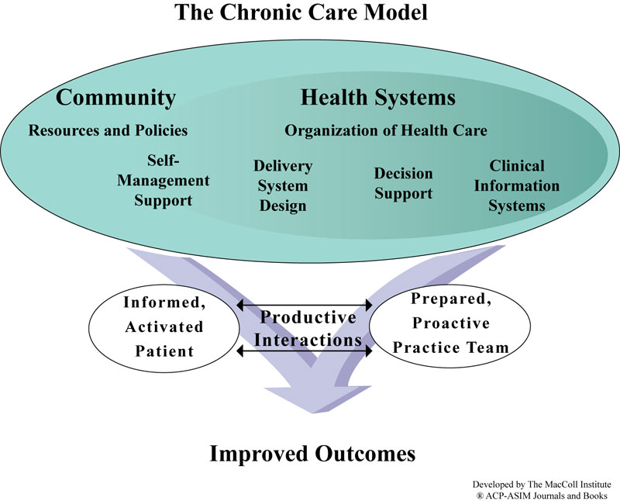

Slide 6
Care Management
What is it?
Identifying and recruiting clients for care management based on service utilization
Client activation and education
Assessing barriers to treatment participation
Monitoring consumer’s participation and response to treatment
Use of clinical registries
Care Coordination
Strategies to help providers communicate with each other
Who does it?
Determined by training & credentials
Best Qualified Social Workers & Nurses

Slide 7
Self Management
Defined by IOM as:
“the tasks that individuals must undertake to live well with one or more chronic conditions”
Programs
Chronic Disease Self-Management Program
Wellness and Recovery Action Plan (WRAP)
Self Management and Recovery Training (SMART)
Screening, Brief Intervention and Referral to Treatment (SBIRT)

Slide 8
Decision Support
Access to Medical Specialists
Time limited
Embedding clinical guidelines
Decision flow charts to navigate evidence-based treatment options
Use of clinical decision support tools

Slide 9
Clinical Information Systems
Organize patient and population data to facilitate efficient and effective care
Provide timely reminders for providers and patients
Identify relevant subpopulations for proactive care
Facilitate individual patient care planning
Share information with patients and providers to coordinate care
Monitor performance of practice team and care system
(http://www.improvingchroniccare.org/)

Slide 10
Team Approach
Interdisciplinary Teams
Primary Care Physician and Nurse Practitioner play key role
Care Manager (Social Worker)
Peer Specialist
Mental Health Provider (e.g., Social Worker, Psychologist, Psychiatrist )
Addictions Professional
Community Health Worker

Slide 11
Inter-Professional¹
“It is no longer enough for health workers to be professional. In the current global climate, health workers also need to be inter-professional”
- WHO, 2010

Slide 12
Defining Inter-professional²
Inter-professional collaborative practice: Occurs when multiple healthcare workers from different professions work together with those they serve (patients, families, caregivers, communities) to provide high quality healthcare
Inter-professional education (IPE): “When students from two or more professions learn about, from and with each other to enable effective collaboration and improve health outcomes.”
Notes:
World Health Organization (WHO). (2010). Framework for action on interprofessional education and collaborative practice. Geneva: WHO. From: http://whqlibdoc.who.int/hq/2010/WHO_HRH_HPN_10.3_eng.pdf

Slide 13
The Need for Inter-professional Education and Competencies³
Integrated behavioral healthcare cannot move forward without a healthcare work force that is trained in and embraces inter-professional collaboration
Our current healthcare system operates predominantly in professional silos
Education of healthcare professionals is also done in silos - few students have an opportunity to work together and are not prepared to function as part of a team in an integrated approach to care

Slide 14
Calls for Change from the IOM^{4, 5, 6, 7}
1972: “How should we educate students and health professionals in order that they might work in teams?”
2000/2001: “How care is delivered is as important as what care is delivered” - requires retraining and inter-professional education
2003: Development of health professions competencies – yet, “interdisciplinary education has yet to become the norm in health professions education”

Slide 15
Benefits of Inter-professional Collaboration
Inter-professional team care improves health outcomes in settings such as acute care or prevention programs⁸
Improves patient experiences of care
Improves efficiency of healthcare delivery
Increases job satisfaction for health professionals⁹
Notes:
These are benefits in need of evidence, though some do exist for acute care and prevention programs

Slide 16
Need for Inter-professional Competencies
Some professions have well developed competencies, e.g., CSWE’s Educational Policies and Standards and ACGME Core Competencies
However, development of IPE competencies has been slow in the US

Slide 17
IOM IPE Competency Domains
In 2003, at an IOM sponsored summer, 5 IPE competencies were identified:
Provide patient-centered care
Apply quality improvement
Employ EBP
Utilize informatics
Work in interdisciplinary teams

Slide 18
Canadian IPE Competency Domains¹⁰
In 2010, the Canadian Inter-professional Health Collaborative published a competency framework and identified 6 domains:
Patient/client/family/community-centered care
Role clarification
Team functioning
Interprofessional communication
Interprofessional conflict resolution
Collaborative leadership

Slide 19
Medical IPE Competency Domains
In 2011, the Interprofessional Education Collaborative (made up of 6 American medical associations) released their core competency domains (38 competencies identified across the domains):
Values and ethics
Roles and responsibilities for collaborative practice
Inter-professional communication
Teamwork and team-based care
Notes:
IPEC: American Association of Colleges of Nursing, American Association of Colleges of Osteopathic Medicine, Association of Schools of Public Health, American Association of Colleges of Pharmacy, American Dental Education Association, and Association of American Medical Colleges

Slide 20
Social Work Roles
Care Coordinators
Care Managers
Patient Educators
Behavioral Health Providers
Mental health
Addiction
Outreach Specialists
Supervisors for Community Health Workers

Slide 21
Social Work Functions
Comprehensive assessment
Care planning
Care coordination
Patient activation
Patient navigation
Patient and family support
Psychotherapy/clinical intervention
Advance care planning

Slide 22
Training
The Certificate Program in Primary Care Behavioral Health is a training program for behavioral health professionals seeking to practice in primary care settings
This training is particularly targeted to prepare behavioral health professionals for the patient centered medical home model
Approved for CEs through NASW

Slide 23
Peer Support Models
As the primary and behavioral healthcare systems have evolved, both have seen a rise in the use of peer navigators and evidence that peer systems add value to each system
Healthcare system use of peers | Behavioral Healthcare system use of peers
Health Navigators-Primary Health Care System | Peer Support Specialists-Mental Health
Promotores/Promotoras-Community Health Workers | Peer Support Specialists-Addiction

Slide 24
Where Social Workers Fit In
Social Work Profession is well positioned to play a major role in a transformed healthcare system
Behavioral health is integrated into the overall healthcare system
Unique skills sets:
collaboration across systems and disciplines;
ecological focus that promotes mobilization of community, safety net and social supports for highly vulnerable populations
Negotiating and overcoming barriers to access to a range of needed services
Values system of the SW professions is in alignment with
Wrap around care for the most vulnerable
Reducing health disparities
Coordinated care

Slide 25
Health Navigators
In 1997, Genesys Healthworks, Flint Michigan implemented a health navigator program using a combination of health coaching, case manager, and care coordinator skills, health navigators help insured and uninsured patients cared for by patient-centered primary care medical homes adopt healthier behaviors and better manage chronic diseases.
As members of the care team, health navigators establish close, supportive relationships with patients through in-person visits and phone calls, helping them set health-related goals and access medical and community-based services and resources to help achieve these goals.
Health navigators may operate out of a practice site or community setting. The program improved lifestyle-related and self-management behaviors, leading to better health outcomes and significant reductions in emergency department and inpatient utilization.
Navigators primarily play a reactive role by trouble-shooting a patient’s problems as they arise. Navigators may be inserted into a health care setting to facilitate adherence to a particular component of care, such as mammography or colon cancer screening. The barriers to be addressed often are not speciﬁed in advance but emerge during interactions with patients.

Slide 26
Community Health Workers-Promotores/Promotoras
All of the world's cultures have a lay health care system made up of people who are natural helpers-community members whom neighbors turned to for social support and advice¹¹
In the United States, formal participation of trained workers in this role has been documented since the 1950s.¹²
The federal Migrant Health Act of 1962 and the Economic Opportunity Act of 1964 mandated such outreach, which included employment of community-based service aides in many neighborhoods and migrant worker camps.¹³
The largest system to formally use the skills of CHWs was established in 1968, when the Indian Health Service adopted the fledgling Community Health Representative Program from the Office of Economic Opportunity. The program was designed to bridge gaps between people and resources and to integrate basic medical knowledge about disease prevention and care with local knowledge.
Currently about 1,400 community health representatives work with tribally managed or Indian Health Service programs in more than 560 federally recognized American Indian and Alaska Native Nations.

Slide 27
Year | Development of Peers in the support and advocacy of mental health and addiction services
1700-1800s | In the 18th and 19th centuries, people within the American Indian and white communities who had achieved sobriety responded to the emerging plague of alcoholism by forming alliances with churches, tribal councils and secular organizations to reach out to others who needed help. These groups formed the first recognizable mutual aid societies in the United States.
1800-1900s | Due to the infancy of the field of mental health treatment and to the social stigma surrounding mental illness, a peer community emerged more slowly for this population. In addition, the lack of legal protection and patient rights allowed “sane” persons and the criminal justice system to commit “insane” persons to hospital confinement for a host of reasons. Abuses suffered by patients in insane asylums are widely documented from the 18th century well into the 20th century.
1840 | In 1840 in Baltimore, 6 alcoholics banded together to form the Washingtonian Movement. Their goal was to achieve abstinence from alcohol and to help others to achieve sobriety. They recognized the importance of shared experience and peer support in achieving this goal, and offered an alternative to the idea that alcoholism was an untreatable moral deficiency. In only a few years, the group had amassed a following of thousands of “reformed drunkards,” throughout the New England region. However, by the end of the 19th century, political involvement and personalities had eroded the group’s original mission and the organization splintered.

Slide 28
Year | Development of Peers in the support and advocacy of mental health and addiction services
1866 | The groundwork for the Mental Health Recovery Movement was being laid in the late 1800’s, beginning with ex‐patients like Elizabeth Packard and Clifford W. Beers who publicly discussed their experiences with involuntary hospitalizations and abuse at state hospitals. Mrs. Packard was involuntarily committed to the Illinois Insane Asylum by her husband after a disagreement over religious beliefs. In 1866, she published a detailed account of the abuse she had received during her confinement which led to a legislative investigation. After a five day trial, Elizabeth was determined to be sane. She embarked on a national crusade to tighten commitment laws to include a jury trial for involuntary commitments. The law passed in Iowa and Illinois, and in modified form in other states. Elizabeth Packard went on to found the Anti‐Insane Asylum Society, continuing her advocacy for patient rights.
1908 | In 1908, Clifford W. Beers published a book describing his experience with mental illness and the treatment he received at a state institution. His book, “A Mind That Found Itself,” invoked public interest in the treatment of the insane and a call for reform. Clifford W. Beers went on to establish the National Mental Health Association, an organization which celebrated its centennial in 2009.

Slide 29
Year | Development of Peers in the support and advocacy for development of mental health and addiction recovery services
1935 | In 1935, Bill Wilson and Dr. Bob Smith began Alcoholics Anonymous. As alcoholics who had unsuccessful experiences with institutional, medical and religious approaches to treatment, they knew what hadn’t worked for them. By sharing their experiences with each other and reaching out to suffering alcoholics, they discovered the power of peer support. In 1939, the first edition of “Alcoholics Anonymous” was published outlining 12 steps and a set of guiding principles establishing the basis for what was to become the most widely successful and long‐ lived mutual‐aid society in the treatment of alcoholism and addiction. AA has served as the spring board for numerous self‐help groups based on the 12‐step tradition, and has also inspired many groups seeking alternative pathways to recovery. AA has become part of the fabric of alcoholism and addictions treatment in the U.S. and around the world.
1940-1950s | The 1940’s and 1950’s began the Mental Hygiene Movement. Autobiographical depictions of life in state hospitals were published; federal investigations and exposes once again documented abuse, neglect and custodial care. Consequently, there was a call for reform and the dismantling of state hospitals.
1970s | The 1970’s marked the beginning of the “ex‐patient movement” in the field of mental health. Consumer‐run programs emerged and consumer support programs were established, including NAMI. This was the time in which other movements, such as the Women’s Rights Movement, Gay Rights Movement and Disabilities Rights emerged. Former patients of the mental health system began to organize to fight for patients’ rights, against forced treatment and to introduce peer‐run services as an alternative to traditional treatment. This was the start of what is now known as the “Consumer/Survivor/Ex‐Patient Movement.” This movement remains active today, organizing ex‐patients, consumers, and advocacy organizations to campaign for improved mental health services, empowerment and choice, rights protection, advocacy and self‐determination.

Slide 30
Year | Development of Peers in the support and advocacy for development of mental health and addiction recovery services
1960-1970s | Also in the ‘60’s and ‘70’s, alcoholism and addiction services underwent critical transformation in both peer‐based and professional arenas. Special populations such as people of color, women, LGBT, and youth formed groups of their own to attend to the culturally‐specific needs of their recovering communities. Researchers and practitioners undertook scientific and controversial studies around the defining elements of alcoholism and drug addiction. Screening tools were developed, standards for diagnosis and treatment were defined which, even today, continue to be revised, and state and national funding streams were put in place.
1980s | The widespread emergence of self‐help/advocacy groups and peer‐run services in the mental health community came about in the 1980’s. Unlike the earlier objectives of abolishing traditional mental health treatment, supporters of self‐help and peer run services wanted to reform the mental health system.
1980s | Mental health reform began in earnest across the United States during the 1980’s, and is evident today in the number of consumers involved in any number of different service levels, local boards, consumer advocacy roles, and in local service provision as peer support specialist. In the recent past, Medicaid has been approving Medicaid services with Peer Support Specialists in paid positions, under supervision delivering peer support services. Many states currently have Peer support credentialing programs in process. Consequently, the number of peers involved in providing peer based services has grown exponentially across the country as the recovery movement has grown.

Slide 31
Year | Development of Peers in the support and advocacy for development of mental health and addiction recovery services
1990s | The 1990’s saw reform legislation with states adopting a recovery approach to treating mental illness. In addition, research by respected leaders in the field of addiction treatment was conducted to show the integral role of Peer Support Services in a Recovery‐Oriented Systems approach to treatment in the U.S. Medicaid approved the first mental health service definitions recognizing the role of peer support specialists as a legitimate way for peer support services to be delivered and reimbursed.
1997 | Genesys Healthworks implemented a peer program on the healthcare side entitled Health Navigators. Today Health Navigators the HealthWorks model is being applied in more than 33 Genesys PHO practices, serving more than 59,000 patients. Vulnerable Populations: Impoverished; Medically uninsured.

Slide 32
Types of Social Support and Peer Support Services¹⁴
Type of Support | Description | Peer Support Service Examples
Emotional | Demonstrate empathy, caring, or concern to bolster person’s self-esteem and confidence. | Peer mentoring Peer-led support groups
Informational | Share knowledge and information and/or provide life or vocational skills training. | Parenting class Job readiness training Wellness seminar
Instrumental | Provide concrete assistance to help others accomplish tasks. | Child care Transportation Help accessing community health and social services
Affiliational | Facilitate contacts with other people to promote learning of social and recreational skills, create community, and acquire a sense of belonging. | Recovery centers Sports league participation Alcohol- and drug-free socialization opportunities

Slide 33
Peer Recovery Support Services
Peer Mentoring or Coaching
one-on-one relationship in which a peer leader with more recovery experience than the person served encourages, motivates, and supports a peer who is seeking to establish or strengthen his or her recovery
Peer resource connecting
purpose of resource connecting services is to connect the peer with professional and nonprofessional services and resources available in the community that can help meet his or her individual needs on the road to recovery
Facilitating and leading recovery groups
The group activities that are structured as support groups typically involve the sharing of personal stories and some degree of collective problem-solving. Many of these groups are formed around shared identity, such as belonging to a common cultural or religious group, or shared experience related to the substance use disorder, such as the need to re-enter the community following incarceration, being HIV positive, or facing challenges in parenting
Building community
Peer recovery support service providers can help such peers make new friends and begin to
build alternative social networks

Slide 34
Assessing Your Organization
Board of Directors
aware of and prepared to respond to health care reform
Workforce
number of staff licensed/credentialed
Patient record
presence of and full use of electronic record
Providing holistic care
Outcome measurement
Quality management principles in place
Patient Health Technology
Administrative Information Technology (IT)
Finance
revenue from third-party billing, adequate cash reserves

Slide 35
Are We Ready?
Organizations are the least ready in the area of
Patient Health Technology
Patient Record
Workforce
Board of Directors
Larger organizations are more ready than smaller organizations
Smaller organizations are currently at a disadvantage when it comes time to forge partnerships needed for integrated care

Slide 36
Promoting Integration¹⁶
Mauch’s keys for the integration of mental disorders and substance use disorders approaches and treatment are applicable in behavioral health/physical health integration
Leadership
Engage Consumers and Stakeholders
Tackle Structural Barriers/Opportunities
Shared aspirations for results
These principles are relevant at every level – from national leadership to a single agency

Slide 37
Health Reform Readiness
Measure
Health Reform Readiness Index¹⁵
Domains
Patient/Family Role involved in decision-making
Evidence-based Treatment
Accountability for Patient Care
Integrated Continuum of Care

Slide 38
Leadership
Balanced and fair leadership
A strong leader or leadership team communicates the benefits of change and serves as a champion for new initiatives
Acknowledges that changing professional roles and professional identify are to be expected
Creates a positive organizational climate by
Fairness
Growth and advancement
Role Clarity (vitally important in times of change)
Notes:
Aarons, M., Sommerfeld, D., & Willging, C. (2011). The soft underbelly of system change: The role of leadership and organization climate in turnover during statewide behavioral health reform. Psychological Services, 8(4), 269-281.

Slide 39
Engage Stakeholders
Vision and mission must be established
Joint planning with key stakeholders including end users (and whatever level) must be ongoing
Find common ground
Deal with roadblocks devise solutions
Define expectations
Report on outcomes
Persistent focus on customers (at all levels)

Slide 40
Tackle Barriers/Opportunities¹⁷
Workforce requirements, training, credentials, recruitment
Align fiscal policy with services
Strengthen quality assurance activities
Develop data driven systems
High-value health care organizations – go beyond the data required by outside parities and collect detail data that informs staff about all phases of the agency

Slide 41
Shared aspirations for results
Client-centered approach
Commitment to evidence-based practice
Continuous quality improvement (CQI)
Transparency – including regular feedback on performance and a commitment to excellence.
Notes:
The complexities of health care integration
Nutting et al., (2011) reporting on a study of demonstration projects moving primary care toward patient-centered medical homes suggests that
Transformation is more than a series simple of incremental changes – and that even two years of ongoing technical assistance and ongoing work was insufficient to completion. In essence the change required is system wide and is basic by impacting core values – be definition resistance to such change will be high (Patti, 1974).
Success came with “those discrete components of the model that could be adapted with minimal impact on individual roles and work identities and that had little impact on other practice processes.”
Difficulties arose with “components that required fundamental changes in established routines and coordination across work groups, or that challenged traditional roles and models of practice. Integration with community services, wellness promotion, proactive population management, and team-based care presented the greatest challenges” (Nutting et al., 2011, p.40).
One particular challenge is the team approach, in particular, envisioning new roles. Physicians are trained to perform autonomously, and when in teams to simply delegate
Putting the client first is more challenging in such system than it seems – and moving toward true community integration and a population focus is even more difficult
The most successful programs had a commitment to organizational learning, what Nutting and associates called “adaptive reserve”
Level 3: Requires a paradigm shift where “practices must transform themselves into highly nimble organizations that work seamlessly as part of the local health care neighborhood to contribute to the health of a defined populations” (Nutting, et al., 2011, p. 441). This likely requires the assumption of risk and prospective payment.
Levels of development
Level 1: Implementing aspects of the model that can be added incrementally to existing systems (same day appointments, electronic medical records
Level 2: Beginning development of functional teams – here there is movement toward “planned, proactive, and population-based teams” (Nutting et al., 2011, p. 441)

Slide 42
Drivers of Change
Survival
Stand-alone behavioral healthcare organizations are a risk in a changing health care and fiscal environment. There are myriad threats and myriad opportunities
Values
Clients are not only included in the formal organizational chart – they are at the top. The key question that should guide healthcare organizations is what should be done to benefit the person served.

Slide 43
What It Takes to Integrate
Is not solely a technical enterprise requires “high touch” as well as “high tech”
Involves changing culture, professional roles, and issues of professional autonomy
Involves adopting flexible professional roles
Requires the hard work of team work
Altering old routines and approaches
There are myriad threats and myriad opportunities

Slide 44
Evaluating Integrated Behavioral Healthcare
Process Outcomes
Improved access
Higher quality of care
More care coordination
Better patient experiences¹⁸
Cost Outcomes
Reduced costs by reducing ER visits, hospitalization & intervention use

Slide 45
Measureable Outcomes
Performance Measures
Reduce 30 day hospital admissions
Reducing avoidable ER visits
Delay permanent nursing home placement
Increase access to PC
Improving patient satisfaction
Decreasing health disparities
Better patient experiences¹⁹

Slide 46
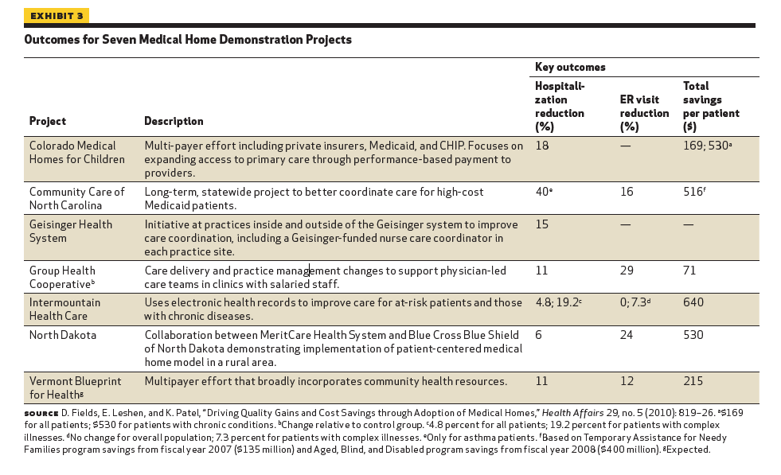
20

Slide 47
Just Do It
Link to CHIS Do it tool (maybe graphic too)

Slide 48
References
World Health Organization (2010). Framework for action on interprofessional education & collaborative practice. Geneva: World Health Organization. Retrieved from http://whqlibdoc.who.int/hq/2010/WHO_HRH_HPN_10.3_eng.pdf
World Health Organization (2010). Framework for action on interprofessional education & collaborative practice. Geneva: World Health Organization. Retrieved from http://whqlibdoc.who.int/hq/2010/WHO_HRH_HPN_10.3_eng.pdf
IPEC. (2011). Team-based communications: Building a shared foundation for education and clinical practice. Conference Proceedings. Washington DC: IPEC.
Institute of Medicine (1972). Educating for the health team. Washington, DC: National Academy of Sciences.
Institute of Medicine (2000). To err is human. Building a safer health system. Washington, DC: National Academy Press.
Institute of Medicine (2001). Crossing the quality chasm. Washington, DC: National Academy Press.
Institute of Medicine (2003). Health professions education: A bridge to quality. Washington, DC: the National Academies Press.
Aston, S. J. et al. (2012). Interprofessional education: A review and analysis of programs from three academic health centers. Academic Medicine, 87(7), 949-955.
IPEC (2011). Team-based communications: Building a shared foundation for education and clinical practice. Conference Proceedings. Washington DC: IPEC.
Canadian Interprofessional Health Collaborative (2010). A national interprofessional competency framework. Vancouver, BC: Canadian Interprofessional Health Collaborative. See: http://www.cihc.ca/resources/publications
Leininger MM. (2006).

Slide 49
References
University of Arizona & Annie E.Casey Foundation (1998). The National Community Health Advisor Study: Weaving the Future.Tucson, Arizona: University of Arizona Press (410-223-2890). Retrieved from http://www.usm.edu/csho/
Hill MN, Bone LR, and Butz AM. (1996). Enhancing the role of community-health workers in research. Journal of Nursing Scholarship, 28(3), 221-226.
U. S. Department of Health and Human Services. (2009). HHS Publication No. (SMA) 09-4454 Substance Abuse and Mental Health Services.
Molfenter, T., Capoccia, V., Boyle, M., & Sherbeck, C. (2011). The readiness of addiction treatment agencies for health care reform. Substance Abuse Treatment, Prevention, and Policy, 7(16)
Mauch, D. (2011). Implementing Mental Health and Substance Abuse Integration: Drivers and Consideration. NASMPHD Meeting, July 17, 2001. Abt Associates.
Bohmer, R. (2011). The four habits of high-value health care organizations. The New England Journal of Medicine, 365(22), 2045-2047.
PCPCC, 2012
PCPCC, 2012
Health Policy Brief: Patient-Centered Medical Homes. Health Affairs, September 14, 2010. Retrieved from http://www.healthaffairs.org/healthpolicybriefs/brief.php?brief_id=25

