Slide 1
Understanding The Brain, Mind, & Psychoactive Substance Misuse
Dr. Audrey Begun, MSW, PhD
The Ohio State University
May, 2020
*Funded in part by the Substance Abuse and Mental Health Services Administration
Notes:
Welcome to this presentation concerning how the brain and mind are involved in the use and misuse of psychoactive substances, … as well as with recovery from substance use disorders.

Slide 2
Acknowledgement
This presentation is part of a 2019 grant awarded to CSWE from the Substance Abuse and Mental Health Services Administration to expand substance use disorder (SUD) practitioner education in social work. During the 2-year project, Expansion of Practitioner Education (Prac-Ed), CSWE will implement a high-quality standardized SUD curriculum, which will strengthen the preparation of future social work practitioners to deliver effective, evidence-based SUD prevention, treatment, and recovery services.
Notes:
Developing this presentation was one commitment in the 2019 Expansion of Practitioner Education grant awarded to CSWE from the Substance Abuse and Mental Health Services Administration. During the 2-year project, CSWE is implementing a high-quality standardized substance use disorder curriculum to strengthen preparation of future social work practitioners to deliver effective, evidence-based substance use disorder prevention, treatment, and recovery services.

Slide 3

Outline
Psychoactive substances & the brain-mind-behavior interface
Understanding neurons & neurotransmitters
Understanding functional areas of the brain
Understanding cravings
Understanding basic pharmacokinetics
Implications of the brain, mind, and substance misuse
Notes:
Following a brief orienting introduction to psychoactive substances and significance of the interface between the brain, the mind, and human behavior, the global topics explored in this presentation include:
What happens at the level of neurons and neurotransmitters with psychoactive substance use,
What happens at the level of brain regions and how this relates to the mind, learning, craving, and behavior with psychoactive substance use,
and implications for informing social workers’ understanding of substance use, substance misuse, substance use disorders, and recovery.

Slide 4
Introduction
Psychoactive substances affect the mind, thus affect behavior
BEHAVIOR/
OUTCOMES
SUBSTANCE
USE
BRAIN-MIND
INTERFACE
(Begun, 2020a, 2020c)
Notes:
Since this presentation concerns psychoactive substances, it seems reasonable to begin with defining what psychoactive substances are.
Psychoactive substances are both naturally occurring and synthetically constructed substances with the power to affect the brain, the mind, and behavior.
Psychoactive substances affect a person’s perceptions, thoughts, emotions, and mood, how their internal and external worlds are experienced and interpreted, and their interactions with their worlds. Because of their effects on the brain, they have a powerful potential for affecting the mind, and because of these effects, a powerful potential for affecting behavior.
Of course, these substances may also affect many other organ systems throughout the body, but in this presentation, we are focusing attention on brain, mind, and behavior effects.

Slide 5
Psychoactive Substances
alcohol*
sedative-hypnotic CNS depressant
cannabis
hallucinogenic & dissociative
CNS stimulants
opioids
inhalants
steroids (androgenic)
other R_{x} & OTC drugs
amphetamines
methamphetamine
cocaine/crack cocaine
nicotine/vaping
caffeine
*See Social Work Grand Challenge: Reducing and Preventing Alcohol Misuse and Its
Consequences; World Health Report on Alcohol; Begun, 2020a
Notes:
Examples of psychoactive substances—sometimes called psychotropics—are listed here:
The list opens with alcohol because, globally, alcohol is one of the most commonly used and misused psychoactive substance. As described in the World Health Organization’s global report alcohol is responsible for a tremendous amount of death, disease, disability, and other social concerns—overall, harmful use of alcohol is responsible for over 5% of the global burden of disease and contributes to 3 million deaths each year.
Among other items in the list of psychoactive substances, you can see the pull-out list of items to consider under the broad umbrella of central nervous system stimulants—they are a fairly diverse group of substances to consider—a mixture of those legally used, those distributed by prescription, and those illicitly produced or distributed. Caffeinated and nicotine containing products are, like alcohol, widely used around the world.
Even more diverse is the set of hallucinogenic and dissociative substances—many of them occur in nature while many others are manufactured substances.
Embedded in the list are the opioids, including misused prescription pain medications, heroin, and fentanyl about which you may heard a great deal in recent years.
The list ends with a catch-all group of frequently misused prescription and over-the-counter substances.
The most important point to retain in all this is that all psychoactive substances are or contain chemicals that react and interact with brain chemistry and possibly with biochemistry in the rest of the body.

Slide 6
Biopsychosocial Perspective
psychological
biological
social & environment contexts
outcomes
Notes:
Social workers’ adoption of a biopsychosocial perspective is ideally suited to understanding alcohol and other drug use, misuse, use disorders, and recovery—a perspective that incorporates interactions between biological, psychological, and social factor and forces into an integrated picture.
Some would add a spiritual domain to this biopsychosocial perspective, while others consider the spiritual component as integrated into the psychological and social domains. The latter conceptualization is adopted in this presentation.
The purpose of this presentation is to tease out from the biological, psychological, and social domains some of what is currently understood about the brain, the mind, and behavior in relation to substance misuse. There exists a great deal more knowledge, evidence, and theory outside of what is presented here that needs consideration for a complete and robust understanding of substance use, misuse, use disorders, and recovery.

Slide 7

Not (Directly) About Genetics
Genetics x social and physical environments
Genetics operating through specific mechanisms
(see Bares & Chartier, 2020; Begun, 2020c; Begun, Bares, & Chartier, 2020; Begun & Brown, 2014; White & Koob, 2020)
Notes:
What we do not address in this presentation are genetics as another of the biological forces involved in substance use initiation and the transition from substance use…to regular misuse… and developing a substance use disorder. The great deal of available evidence concerning genetic influences and the interplay between genes and environment in shaping these outcomes is beyond the scope of this presentation—but is not irrelevant.
Genetics play a significant role in the neurobiology of substance misuse—rather than addressing the complex genetic patterns involved, in this presentation we focus on mechanisms through which genetics impose their impact.
For example, genetics can influence the level of neurotransmitters and receptor density present in a person’s brain; this, in turn affects the nature and intensity of a person’s response to substance use. Other resources explain genetic and epigenetic influences on substance misuse and other addictive behaviors.

Slide 8
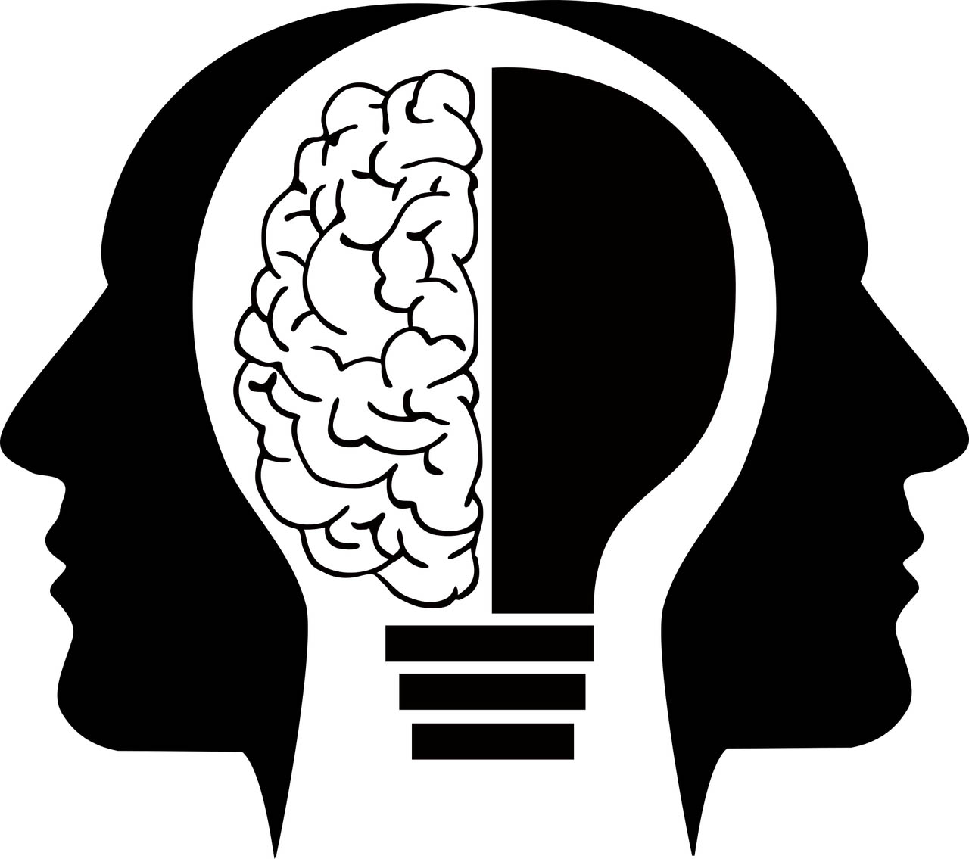
Brain – Mind Interface
hardware
software
adapted image from Gordon Johnson, Pixabay
Notes:
What we do address in this presentation are the intersections and interactions between the brain, the mind, and behavior.
This image is intended to help establish this context. If you apply the analogy of a human brain being like a computer, the physical brain and central nervous system could represent the hardware.
The mind could be the software. The brain and mind, like hardware and software, operate together to produce observable outcomes in terms of human experience and behavior.
On one hand, what happens in the brain affects what happens in the mind—a person’s perceptions, cognitions, learning, memory, emotions, motivations, and behavior. This is all influenced by what happens at the physical “hardware” level. On the other hand, a great deal of evidence indicates that what happens in the mind and behavior also influences the hardware of the brain. Some ways that can change the mind can effect changes in the brain, as well.
With this orientation under our belts, we now explore what happens at the microscopic level of neurons when substance misuse occurs.

Slide 9
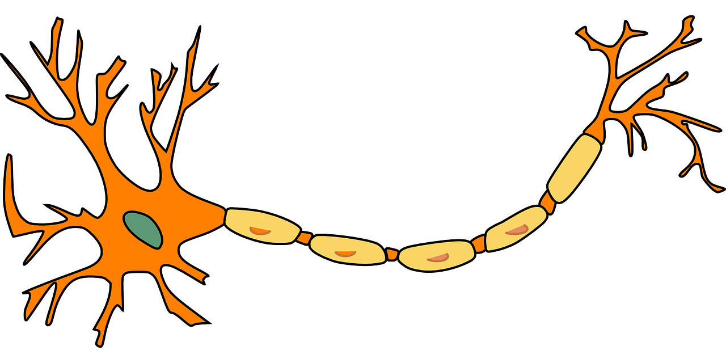
Neurons & Neurotransmitters
dendrites
axon
cell
body
axon
terminals
Notes:
The human brain is primarily comprised of billions of neuronal and glial cells—we are focused here on the nearly 100 billion NEURONS as the brain’s main information processing units. But, keep in mind that intense scrutiny is currently under way to determine the roles glia might play in substance misuse and recovery—so stay tuned to that developing area of neuroscience.
Neurons are organized in complex networks with each individual neuron acting as a switch determining whether information passed to it will or will not be passed on from it to other neurons—sometimes thousands of others. When a neuron receives enough incoming signals from other neurons it activates, or fires off an electrical impulse, passing along its own signal to the neurons it connects to.
In the general course of things, messages come into a neuron from other neurons through the many dendrites extending from its cell body. The electrical impulse, if triggered, then passes along the axon and passes to other neurons from the axon terminals.
Important in understanding the brain’s response to substance misuse is understanding what happens at the points of communication between neurons.

Slide 10
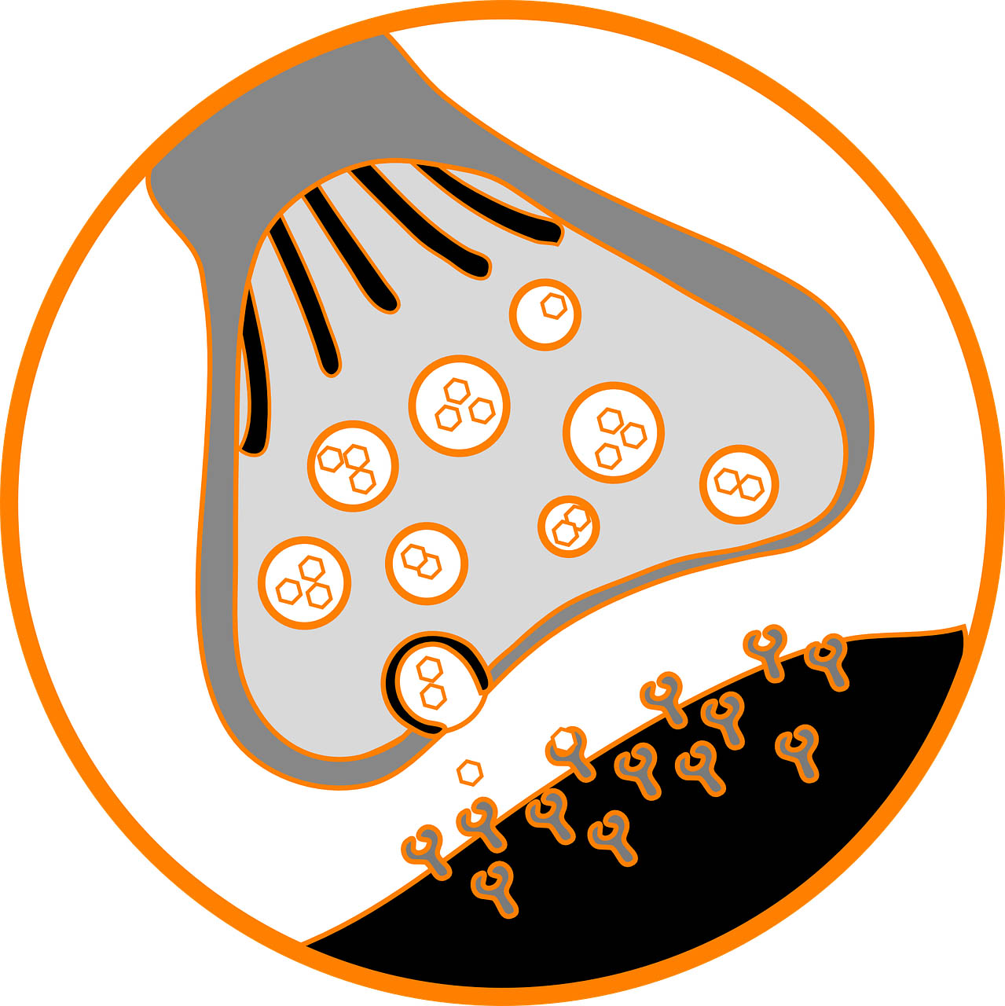
Synapse
vesicles
neurotransmitters
sending
neuron’s
axon terminal
(presynaptic)
receptors
receiving
neuron’s
dendrite
(postsynaptic)
synapse/
synaptic cleft
Notes:
Neurons communicate via neurotransmitters. These are chemical substances released from the axon terminals by an electrical impulse travelling down along the neuron. The neurons, or nerve cells, do not actually touch each other. The communication is in the form of these neurotransmitters passing back and forth in the space between neurons. This diagram represents a super closeup view of a single axon terminal from one neuron communicating with a single one of another neuron’s dendrites. This is going on all around this single pair with these two and many other neurons at the same time.
The gap or space between the first neuron’s axon terminal and the second neuron’s dendrite is called the synapse—or, sometimes, the synaptic cleft. This makes the first neuron the presynaptic neuron—it is the one potentially sending a message to the other. The second neuron is the postsynaptic neuron and is the one potentially receiving the first one’s message.
The axon terminals on the presynaptic neuron hold pockets of stored neurotransmitter chemicals.—these pockets are called vesicles.
In the normal course of events, when a whole neuron has built up enough charge from multiple incoming messages, it is triggered to release some of its stored neurotransmitter chemicals into the synapse between it and the receiving neurons—releasing the neurotransmitter chemicals into the synapse.
As the neurotransmitter chemicals are transported across the synapse, protein-based receptor structures on the receiving postsynaptic neuron’s dendrites may pick them up. This will happen only where the shape of each receptor fits the type of neurotransmitter being released—kind of like a lock and key or two puzzle pieces fitting together. Also, the receptor msut be open and available to receive the neurotransmitter—not already full or otherwise blocked.
Eventually, when the communication ends, the neurotransmitter chemicals are transported back across the synapse and stored back in the vesicles for next time—this is called the reuptake process.

Slide 11
Neurotransmitters
Excitatory
Inhibitory
dopamine
norepinephrine & epinephrine
glutamate
dopamine
serotonin
GABA (gamma-aminobutyric acid)
acetylcholine
endorphin
Notes:
Different types of neurotransmitters have different types of action on the central nervous system.
A neurotransmitter chemical may be of the type that stimulates action—these are excitatory neurotransmitters.
Or, a neurotransmitter chemical may be of the type that dampens down and suppresses action—these are called inhibitory neurotransmitters.
A few types of neurotransmitters can be either excitatory or inhibitory, depending on the type of receptor involved in the communication exchange—dopamine is an important neurotransmitter of this dual functioning type.
Examples of excitatory neurotransmitters commonly involved in psychoactive substance use are:
norepinephrine and epinephrine, also known as noradrenaline & adrenaline, and a third is glutamate.
Examples of inhibitory neurotransmitters commonly involved in psychoactive substance use are:
Serotonin, gamma-aminobutyric acid/nicknamed GABA, acetylcholine, and endorphin—the name endorphin is actually short for endogenous morphine, so named because it occurs naturally in the body—that is the endogenous part—and its structure is similar to morphine—one of the opioids.

Slide 12



Neurotransmitters & Receptors
opioid
opioid
receptor
methadone
opioid
opioid
receptor
opioid
non-opioid
receptor
opioid
Notes:
This is where substance misuse comes into the picture. The human brain naturally has certain types of receptors like opioid receptors and cannabinoid receptors because of chemicals naturally produced in the body—endocannabinoids, for example. The endogenous opioids naturally produced in the body include enkephalins, endorphins, and others.
On the top, we see an example of a naturally occurring opioid receptor being able to accept an opioid—this could be heroin, methadone, fentanyl, or any of a number of opioid pain medications like oxycodone, hydrocodone, codeine, or morphine. In this case, the receptor is one of many located on the postsynaptic neuron’s dendrite and is structured to accept the opioid substance—allowing the opioid, if enough receptors pick it up, to affect the receiving neuron.
On the bottom, we see a receptor that is not structured to accept the opioid—it is structured to accept some other substances or neurotransmitters, but not the opioid it encounters. In this case, the opioid has no effect on the postsynaptic neuron.

Slide 13

Antagonists and Agonists
opioid
opioid
receptor
methadone
opioid
opioid
receptor
opioid
receptor
antagonist
opioid
agonist
(see Portelli, Munjal, & Leggio, 2020)
Notes:
The principles of antagonist and agonist drugs helps explain how administering pharmacotherapy agents might help treat a substance use disorder—pharmacotherapy involves the use of specific medications to help support recovery from a psychoactive substance use disorder.
At the top, we are reminded of the situation where the opioid is picked up by the opioid receptor, and the opioid can affect the postsynaptic neuron.
Certain pharmacotherapy agents can interrupt that relationship and reduce or eliminate the opioid’s potential effect.
On the bottom left, is the antagonist scenario.
Antagonists are two entities acting in opposition to one another. A prime example is the relationship between opioids, like heroin or fentanyl, and the antagonist drug called Narcan used to reverse an opioid overdose. Narcan blocks opioid receptors from binding with the opioid without unlocking the receptor itself—it doesn’t fit into the lock itself; it simply seals or blocks the receptor from receiving the opioid.
Receptors may have a stronger affinity for the antagonist than for the opioid—in this case, the antagonist can actually displace the opioid from matched receptor sites.
With these blocking antagonist functions, neurons down the line are not activated by the opioid. So, an antagonist interferes with the action of the substance. Some antagonists also accelerate the reuptake of the neurotransmitter hanging around in the synapse, making less of it available for binding with the receptors.
On the lower right side we see the agonist scenario played out.
Agonists, mimic the neurotransmitter or substance they correspond to. The agonist does fit the receptor locks and can fill them so the opioid keys cannot connect. The agonists themselves will have some effect on activating the receptors, but the effect may be more controlled or desirable than what would have happened with the opioid. Methadone is an example of an opioid agonist. As an agonist, methadone does produce some opioid effects. This can help minimize a person’s experience of withdrawal symptoms without creating the same level of euphoria or “high” as the original opioid.
Antagonists and agonist drugs are used in pharmacotherapy with substances other than opioids, too—for example, these principles are behind some medication therapies to help a person reduce or kick their cigarette habit., and others to help someone reduce or quit drinking alcohol.

Slide 14
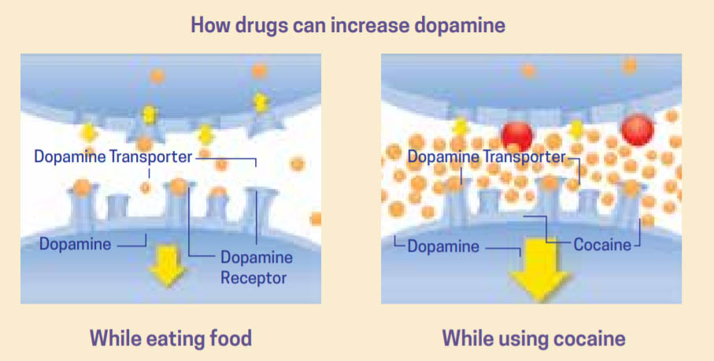
Endogenous vs Exogenous Sources
(image from NIDA 2018 Drugs, Brain and Behavior: The science of addiction)
Notes:
Understanding what happens at the neurotransmitter level also helps explain why substances have so much power to cause addiction.
When someone engages in a natural behavior like eating or sex, a surge of dopamine is released—these natural behaviors are endogenous sources of neurotransmitter activation.
Psychoactive substances introduced from the outside are exogenous sources of neurotransmitter activation.
Alcohol and other substances influence how much neurotransmitter is released from the presynaptic axon terminal, how much is received by the postsynaptic dendrites, and how long it hangs around in the synapse before being transported back to the presynaptic axon terminal.
In the example diagrammed here, exogenously introduced cocaine not only stimulates a surge of dopamine release, the amount released is many times the amount naturally released by eating. The cocaine also interferes with dopamine reuptake so the dopamine is present in the synapse longer than would naturally occur, allowing it to connect and reconnect to more of the receptors over time.
The rate and magnitude of the dopamine release drives the intensity of the reward experienced. This helps explain why substance use can eventually take precedence over other types of pleasurable activities once enjoyed—interacting with loved ones, eating, working, engaging in hobbies, and other endogenously pleasurable behaviors that cannot produce the same intensity of reward exogenously stimulated.

Slide 15
Functional Regions of The Brain
According to the National Institute on Drug Abuse (NIDA, 2018), addiction:
“… is considered a brain disorder because it involves functional changes to brain circuits involved in reward, stress, and self-control, and those changes may last a long time after a person has stopped taking drugs.”
Notes:
This leads us to look at what is happening at a larger level in the system—the pleasure and reward system, and other functional regions of the brain.
Neurons with different types of neurotransmitters and receptors are not evenly distributed throughout the brain—some areas are more richly populated than other areas with dopamine release and receptor systems, for example. Thus, some brain regions are more involved than others in responding to substance use.
Over time, these regions begin to change in response to the presence of exogenously introduced substances, with addiction being one possible result. For this reason, addiction is considered a brain disorder.

Slide 16
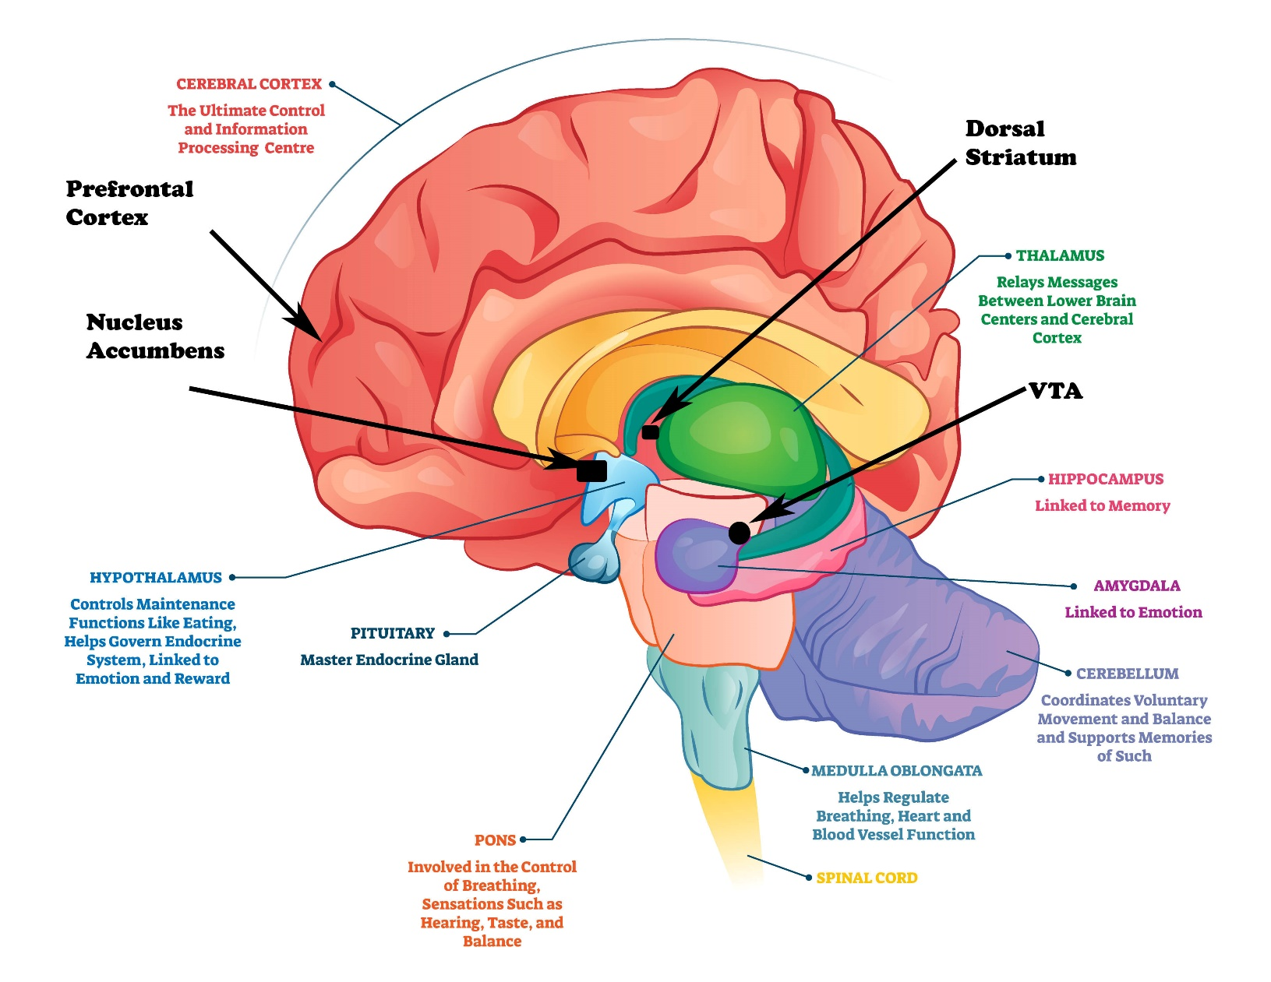
Functional Regions of The Brain
image adapted from normaals at 123rf.com
(see White & Koob, 2020)
Notes:
Let’s look at what is involved at this level.
The human brain is a complex organ comprised of multiple interacting structures. Certain structures or areas of the brain play a role in substance misuse. This diagram identifies several functional brain regions that play a role in memory, emotions, perception and sensation, balance and coordination, and information processing or thinking. 4 areas are marked in black—the VTA, nucleus accumbens, dorsal striatum, and prefrontal cortex. These areas play a key role in substance misuse and substance use disorders. They are all part of the reward pathway in the brain.
This flat, 2-dimensional diagram is not a great representation of the multi-dimensional reality. Marked areas descend deeper inside the model and cover more area that it appears here.
Another major limitation in this diagram is the way it makes the brain areas seem distinct and having clear boundaries. In fact, these areas are heavily interconnected by neural pathways. This is how the brain regions communicate and coordinate their activities.
In substance misuse, an exogenously introduced substance like alcohol or cocaine activates the ventral tegmental area, identified here as the VTA. The VTA uses neurotransmitters like dopamine to send messages to the nucleus accumbens – an area involved in motivation and the experience of reward.
The nucleus accumbens is populated with various types of neurons—those that communicate with dopamine, others communicating with glutamate, and still others with GABA. For this reason, the nucleus accumbens plays a key role in different kinds of substance misuse—some substances activate the dopamine release system, others activate endorphins or opioid release systems, or the glutamate or GABA systems may be involved. Alcohol use, for example, seems to involve dopamine, GABA, glutamate, and enkephalon endorphins—multiple different neurotransmitters.
At the same time, the VTA also sends messages to the dorsal striatum which is involved in forming habits—behavioral routines that can more easily be re-enacted time and time again with little thought being applied.
These areas are connected to the prefrontal cortex, which has a major role for “executive” cognitive functions—thought processes that regulate emotions and impulses, organize activity, prioritize tasks, manage time, make decisions, and otherwise represent “the mind”.
All together, these functional brain regions create a positive rewarding experience with the substance use, store the memory of the experience, learn about the experience, and think about the experience. These systems form the basis of the positive reinforcement mechanism that is so crucial in learning to repeat behaviors that trigger the reward system experience.
In other words, taken together, these are the functional areas where a person learns to associate the reward experience with substance use.

Slide 17
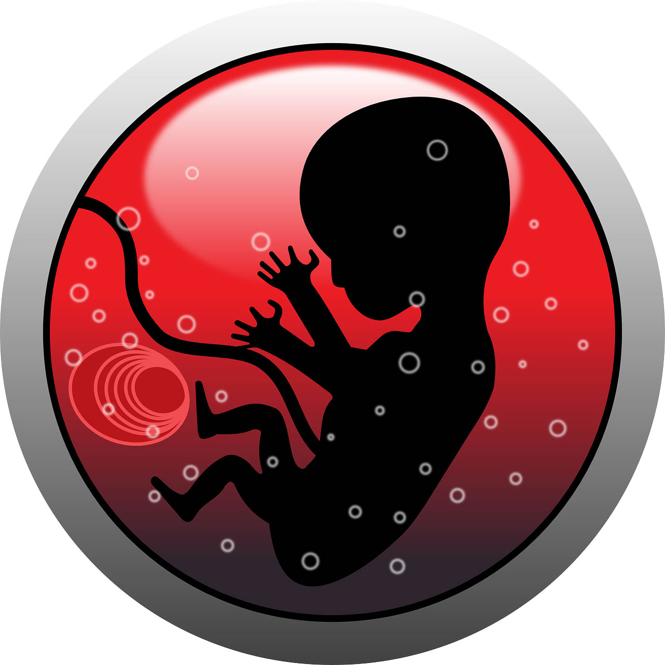
Developmental Period
Prenatal Exposure: Expansion
            FASD
            ARND
            ARBD
            FAS
(see Begun & Brown, 2014)
Notes:
Before we look into the reinforcement and reward pathways in a little more detail, another important topic needs to be identified, if not fully explored.
The human brain undergoes rapid developmental changes at different periods of the lifecycle.
These are periods when the brain is much more vulnerable to alterations resulting from exposure to alcohol and other substances.
The first of these peak sensitivity developmental periods occurs during prenatal development when the number of neurons and complexity of brain regions is rapidly expanding. The teratogenic effects of alcohol exposure during this period CAN have lifelong effects on the brain and many other organ systems. Fetal alcohol exposure outcomes can range from non-evident to severe and irreversible neurodevelopmental effects. This FASD continuum, meaning fetal alcohol spectrum disorders, includes ARNDs which refers to the group of alcohol related neurodevelopmental disorders, ARBDs which refers to alcohol related birth disorders like alterations in facial features, the heart, hands, and other body parts; and what is known as FAS or fetal alcohol syndrome which encompasses the most severe forms of fetal alcohol exposure effect.
Other substances like central nervous system depressants and opioids are known to cross the placenta and may impose different neurodevelopmental alterations, as well as affecting other organ systems—not all of these are as well understood as fetal alcohol exposure, and often the developmental effects are not immediately evident. The effects may show ups days, months, or even years later sometimes showing up as challenging behavioral or learning problems as the child enters school.
Worth noting is that many effects of fetal exposure are not reversible—they are lifelong and can affect many aspects of mental and physical development and health. However, early identification affords great opportunities for early intervention that also can have positive lifelong impact, as well.

Slide 18
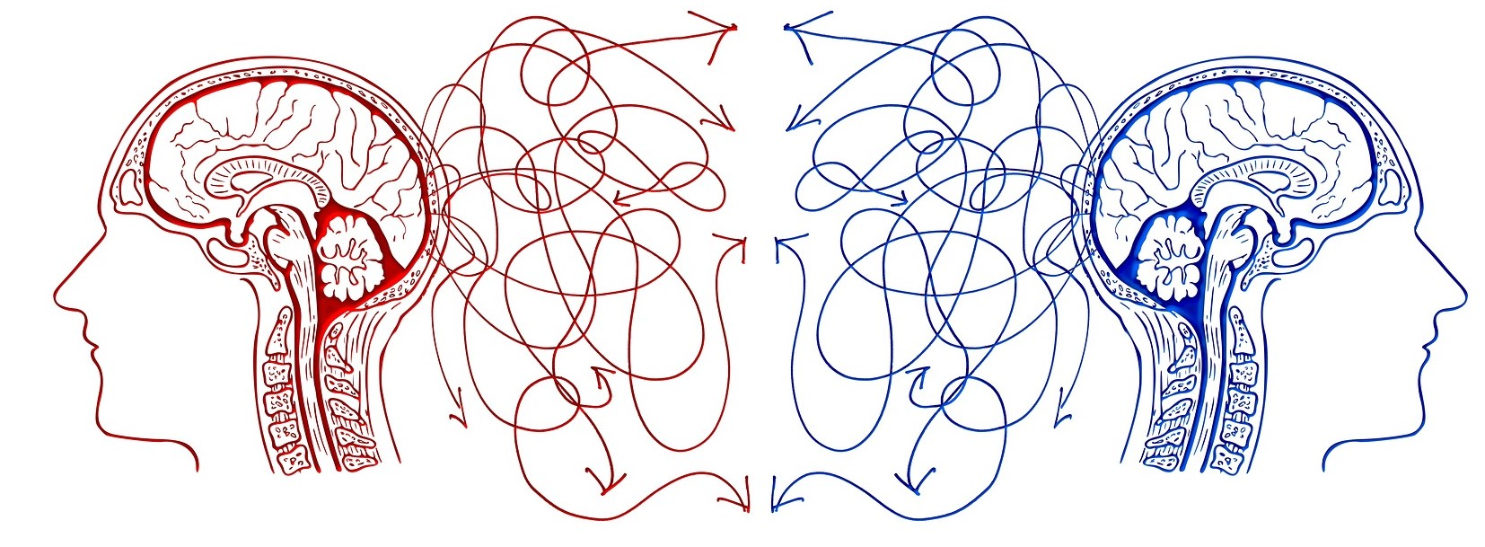
Developmental Period
Adolescence/Emerging Adulthood: Reorganization
image from geralt at Pixabay.com
Notes:
Another peak sensitive developmental period begins early in adolescence and extends through the period of emerging adulthood.
During this rather lengthy developmental period, the human brain undergoes a process of neuron and brain region reorganization whereby unused neuronal pathways are pruned away and others are strengthened. The amygdala and prefrontal cortex are significantly reshaped during this reorganization process. Exposure to alcohol and other substances during this period has the potential to greatly impact brain development, especially considering the important roles these brain regions play in substance misuse.
Adolescents who engage in alcohol or other substance misuse may experience even more intense pleasure and reward responses than adults, making them even more susceptible to a substance’s addictive potential. Unfortunately, this heightened sensitivity occurs during a period when inhibitory control functions lag behind behavior initiation functions--expressed in the form of adolescents’ and emerging adults’ greater risk taking and impulsiveness. These brain changes help explain evidence that initiating substance use during adolescence is associated with a greater risk of developing a substance use disorder at some point during a person’s lifetime compared to delaying initiation until adulthood.

Slide 19
Positive Reinforcement
Receiving desirable feedback in response to substance use is a powerful motivator for repeating the behavior…
(White & Koob, 2020, p. 63)
substance use
positive reinforcement
repeat substance use
Notes:
Turning back to the learning and reinforcement topic, we bridge the mind-brain interface—operant conditioning principles from learning theory tell us that when the consequence of engaging in a certain behavior is experienced as positive, that positive experience is reinforcing, which means the behavior that elicited that positive consequence is likely to be repeated in the future. [pause]
This means that if a person uses a substance—say cocaine—for the first time and experiences a positive result from what is happening at the neurotransmitter level, the person is more likely to repeat use of the substance again in the future.

Slide 20
Negative Reinforcement
Two types of consequences reinforce (reward) behavior—delivering a positive stimulus or removing a negative stimulus…
(Begun, 2020, p. 102)
substance use
negative reinforcement
repeat substance use
Notes:
Instead of adding a positive consequence, removing an unpleasant experience is also a reinforcing behavioral consequence: the behavior that led to removing that negative experience is likely to be repeated in the future.
Here, that means that if a person who feels anxious uses a central nervous system depressant like alcohol and finds the anxiety is lessened or disappears because of what is happening at neurotransmitter and functional brain region levels, the person is more likely to repeat use of the substance again in the future when anxiety strikes.

Slide 21
Opioids
Both negative & positive reinforcement
Pain
Remove Pain
Negative Reinforcement
opioid
Pleasure
Positive Reinforcement
Notes:
Opioid misuse is an intriguing example—not unlike alcohol and benzodiazepine. These substances have the power to reduce pain and some other unpleasant feelings like anxiety, for example. The removal of a negative stimulus like pain or anxiety is rewarding and reinforcing—it increases the probability of taking that substance again in the future.
At the same time, opioid use may also be positively reinforcing—it is stimulating the pleasure and reward system in the brain at much greater intensity than normal behaviors can exert. Together, these positive and negative reinforcement phenomena increase the probability of taking opioids again the future and boost the addictive potential associated with these substances.

Slide 22
Punishment
…and two types punish the behavior—delivering a negative stimulus or removing a positive stimulus.
(Begun, 2020, p. 102)
negative consequence
decreased probability of future use
substance use
Notes:
It also makes logical sense that a person experiencing a NEGATIVE consequence from substance use will be less likely to repeat that behavior again in the future.
This is the operant conditioning learning principle of punishment in action. The punishing consequence might involve the substance making them feel very anxious or depressed or sick. This is the learning principle associated with the earliest pharmacotherapy approach to managing alcohol use disorder and interrupt heavy drinking behavior. Disulfiram, commonly known as Antabuse, causes a person to experience very unpleasant effects when combined with alcohol use—sweating, flushing, nausea, vomiting, heart palpitations, vertigo, and other effects punishing the drinking behavior almost immediately. Ideally, the person soon learns to avoid alcohol.
Other punishing consequences of substance misuse might involve emotional or personal costs like feeling shame or suffering the loss of a parent’s or partner’s approval and respect. It might be health damage, job loss, loss of family and friends, incarceration, or the high monetary cost of acquiring the substance. Any of these might become teachable events.
Logic would argue that a punishing consequence like hangover—feeling very sick—following an episode of heavy alcohol use would discourage someone from doing it again. Or, from having to pay large fines related to a drunk driving episode would prevent a repeat performance of that behavior.
Unfortunately, in learning terms, these types of punishing consequences have two strikes operating against them.

Slide 23

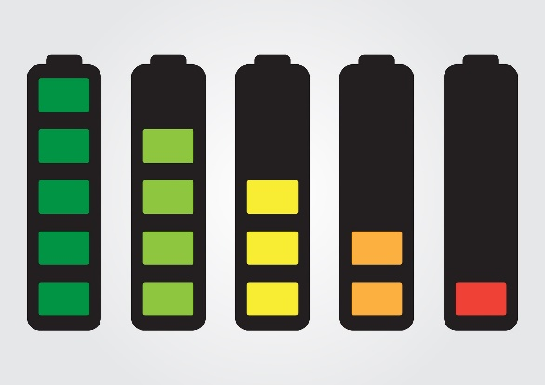
Sequencing & Timing
first consequence= most impact
loss of immediacy= loss of impact
Notes:
First, if someone feels good or experiences a high after using a substance, the reward arrives before the punishment of hangover or court-imposed penalties.
In learning terms, the first consequence to arrive in response to a behavior generally has more power to shape future behavior than those arriving later. In other words, the positive rewarding consequence may break the behavior to punishment learning link.
Second, like a battery losing power over time, the potential impact of a learning consequence to shape future behavior generally diminishes when too much time passes between the behavior and the consequence. For many individuals, feeling sick with a hangover may take too long to have a powerful impact on learning not to drink to excess in the future. Paying court fines may happen months after the drunk driving behavior, diminishing its power as a deterrent to behaving this way again in the future.

Slide 24




Craving
bell ringing = no drool response
(bell=UCS)
food = drool response
Notes:
Another aspect of learning involves memory. The hippocampus and the frontal cortex play crucial roles in memory.
With memory, the reward system can be activated in reward anticipation, not just when a reward actually occurs.
This mechanism is at the root of cue-induced craving experiences—Craving is about a person’s attention and reward system anticipating the reward experience when triggered by relevant cues—these could be sights, sounds, smells, tastes, emotions, and other cues associated with past substance use. This is what happens in the brain when classical conditioning or conditioned learning takes place—when a previously NEUTRAL stimulus becomes paired with a consequence and can provoke an anticipatory response all by itself.
You may recall Pavlov’s experiments with dogs, a bell, and food. Initially, ringing a bell led to no drooling response from dogs, it was irrelevant. But a bowl of food made the dogs drool. Here, the bell is an unconditioned stimulus.

Slide 25
Craving as Conditioned Learning
bell = conditioned stimulus (CS)
drooling = conditioned
response (CR)
conditioning phase
Notes:
Next, dogs were fed repeatedly with the bell ringing. Eventually, even without the introduction of food, the bell alone could provoke a drooling response.
Now the bell has become a Conditioned Stimulus with drooling as a Conditioned or CUE-INDUCED Response to the bell. At the risk of anthropomorphizing the dog’s experience, we could say that the bell has become a craving trigger for the dog expecting the food reward.
The VTA or ventral tegmental area we previously discussed is part of a brain region called the ventral striatum that is heavily involved in the experience of craving and reward-seeking through addictive behavior.

Slide 26


Craving as Conditioned Learning
music became a conditioned stimulus (CS)
(cue induced/craving trigger)
(image from Markus Spiske at Pixabay.com)
Notes:
Consider how previously UNCONDITIONED stimuli might become CONDITIONED stimuli in the context of substance misuse.
Addiction researchers can trigger an alcohol or cocaine craving response by simply presenting images of alcohol or cocaine use paraphenalia in study participants who experience an alcohol or cocaine use disorder. When monitored through functional brain imaging, investigators can see that areas of the brain activated by these conditioned cues are the same as those activated by use of the substances—they are witnessing the results of a cue-induced response.
By the way, for this reason, presentations like this are purposely devoid of the most common cue triggers and graphic images—presenters don’t want to trigger a craving response in audiences with substance use experience.
Cues that trigger craving may be unique to an individual—for one person seeing a neon beer sign outside a bar or walking in the same neighborhood where they used to drink or use drugs may serve as a craving cue. For someone else these cues might remain an irrelevant unconditioned response, but that person may crave a drink when seeing someone on tv pouring a beer or shot of liquor. Someone might find a craving for coffee provoked by the smell of fresh coffee brewing. Seeing drug paraphernalia may be a cue trigger for someone who was heavily engaged in the ritual of setting up to use cocaine or heroin; and, some individuals who smoke cigars begin to experience a physiological response as they begin the ritual of preparing to smoke a cigar, before the chemicals can begin to have an effect.
One woman interviewed about her own personal cannabis use triggers replied: “loud music being played outdoors because this is where I first learned to use it—at outdoor concerts and music festivals.” Another woman was able to quit smoking cigarettes after she graduated from high school and went away to college. However, when she returned for their 10-year high school reunion, she found the craving to smoke again with these old friends was compelling and she relapsed to regular smoking for years until she was able to succeed in another quit attempt.
Cue-induced responses can be triggered by the kinds of external stimuli presented so far. But cravings can also be driven by internal physical or emotional states serving as stimuli. For example, negative feelings like anxiety or anger may become conditioned stimuli if drinking or another substance was frequently used when feeling this way.

Slide 27

Craving Experience
image from Stefan Keller at Pixabay.com
“But all such facts are remote and unsubstantial compared with the near, felt fact of a craving, here and now, for release or sedation, for a drink or a smoke.”
-Aldous Huxley
(see Edguer & Taylor, 2020; Zweben & West, 2020)
Notes:
The craving experience can become compelling—overshadowing a person’s other thoughts and drawing their attention away from other pursuits and important activities, introducing a great deal of distraction and interference with a person’s ability to concentrate, focus attention, and perform other mental, social, and physical tasks.
Cravings tend to build in crescendo over the short run, and eventually, after hitting a peak, begin to diminish over time. It can require a great deal of resistance over hours and days to get past a craving episode without relapsing.
As previously mentioned, pharmacotherapy approaches may help manage cravings as a means of supporting quit attempts and recovery efforts. Ideally, disrupting the link between expected reward and substance use behavior makes a quit attempt and recovery effort more likely to succeed.
In addition, mindfulness practices and other behavioral interventions either alone or in combination with pharmacotherapy have important, evidence-supported roles to play in cravings management and relapse prevention. Mindfulness practices and numerous behavioral intervention approaches offer a means of intentionally thinking and behaving in ways that interrupt previously learned pathways and substance-induced brain mechanisms—these are ways that the mind and behavior can be engaged to influence the brain.

Slide 28
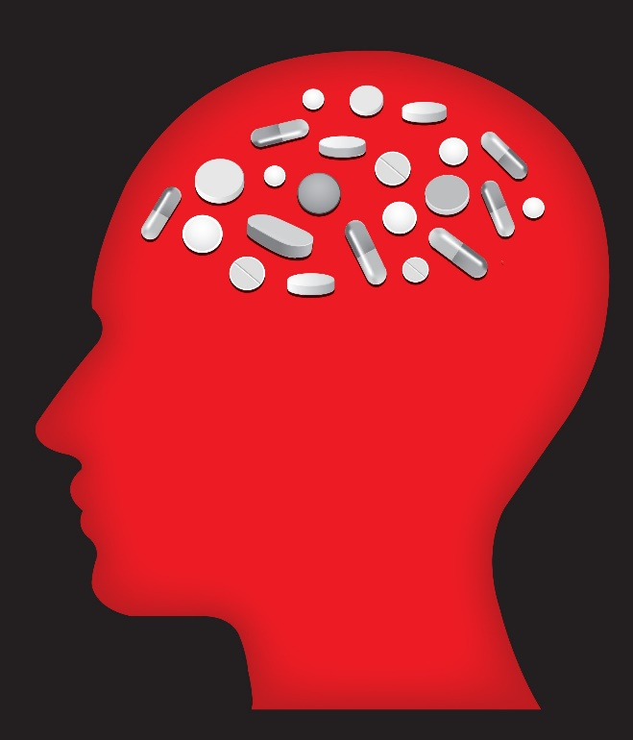
Pharmacokinetic Principles
speed and intensity
short- vs long-acting
tolerance & sensitization
withdrawal symptoms
image from Lara Arh @123rf.com
Notes:
Our next task is to examine a few basic principles concerning the pharmacokinetics of substance use.
The main topics relate to the speed and intensity with which a substance’s psychoactive effects are experienced, the duration of the experienced psychoactive effects, development of tolerance and sensitization to the substances used, and implications of withdrawal symptoms.
Each of these principles has important implications for how the brain and mind respond to alcohol and other substances.
In turn, they have important implications for substance use, misuse, use disorders, and recovery, as well as how pharmacotherapy support recovery.

Slide 29

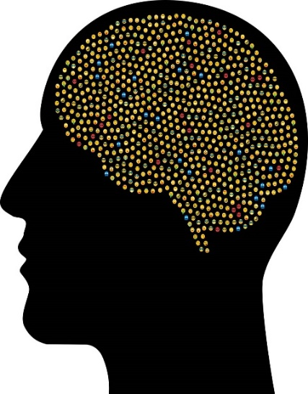

Speed & Intensity
Notes:
The speed and intensity with which psychoactive substances reach the brain and a person begins to experience their effects has a profound influence on addictive potential. Even though all psychoactive substances eventually get to the brain, the speed and intensity of arrival matter in terms of addictive potential. The more immediately and more intensely the brain’s reward systems are activated, the stronger the learned response to using the substance becomes. Some substances are faster actors than others—nicotine, for example, is a relatively fast and intense acting substance compared to some others. The circulating dose of a substance has a lot to do with the intensity of it action, too.
Mode of administration matters in both speed and intensity of initial effects, as well. For example, INJECTION is faster than INGESTING a substance in pill, food, or drink form where it passes through the digestive system before the psychoactive chemical enters circulation in significant concentrations–inhaling a substance in smoke or “snorting” it also is faster and more intense than the same amount of a substance being ingested as pill, food, or drink.
Mode of administration also has significant physical and public health implications—for instance, exposure to infectious disease is heightened with injection use, and development of respiratory diseases increases with smoking.

Slide 30
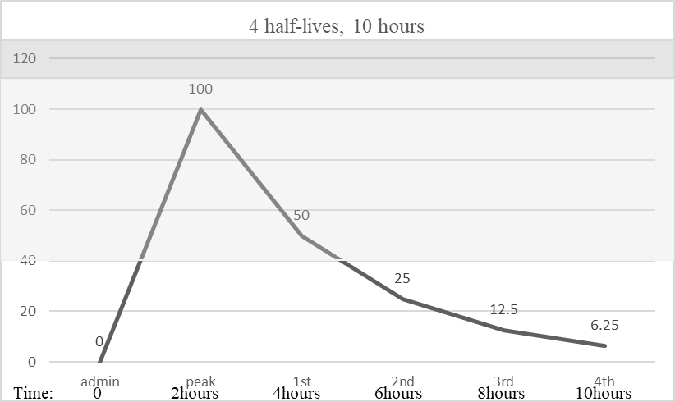
Half Life (Short- vs Long-Acting)
overdose
risk zone
effect
zone
(graph adapted from Begun, 2020a)
Notes:
In addition to how quickly and intensely a substance STARTS to work, how long its effects last is also important.
This has to do with the rate at which a substance is metabolized or broken down in the body and how that rate intersects with the circulating dose needed to feel effects.
This graph depicts the action pattern for a hypothetical drug.
The pharmacokinetic definition of drug half-life refers to point at which a drug’s circulating dose is cut in half—it has been 50% metabolized and 50% remains in circulation at its first half-life. The next half-life is when 50% of what remained is then metabolized—leaving only 25% in circulation (50% of 50% equals 25%). The third half-life is when the next 50% is metabolized—half of 25% is 12.5%, and so on until the substance is completely metabolized and no longer circulating in the body.
In this hypothetical diagram, the range of this drugs effect is when it is at or above 40% circulating. That means the person started feeling its effects about 1 hour after taking it—when about 40% was circulating. They would continue to feel the effects until about 5 hours after taking it—the point when only about 40% remains after hitting the peak 100% at around hour 2.
In this graph, the first half-life point happens at about 4 hours—about 50% of the peak amount has been metabolized and about 50% remains.
The next half life—when it goes from 50% being available down to 25%--occurs at about 6 hours after administration. Here, the person may not be feeling any of the effects any longer, despite there still being some of the drug in circulation.
At about 8 hours, there is only about 12.5% of it in circulation, and at 10 hours only about 6.25%.

Slide 31
Half Life (Short- vs Long-Acting)
overdose
risk zone
effect
zone
Notes:
Of concern is that the person may take another dose of the drug at about 4 hours in anticipation of losing the effects around the 5th hour. The new dose will hit its own peak at about hour 6—about 2 hours after administration, like the first dose did. Adding that peak to what is remaining in circulation from the prior dose could easily take the person into the danger zone where the high risk of overdose exists. The red line shows how this second dose is going to exceed that overdose risk zone even before it is at 100% of its own peak.
A drug’s period of action and effect can work to our advantage, too—for example, methadone is longer acting than heroin. This fact contributes to its helpfulness in treating opioid use disorder—a person learns that methadone staves off withdrawal effects more steadily, reliably, and for a longer period than heroin. It is also safer in the sense that it is produced and distributed under more controlled circumstances, so that its pharmacokinetic actions are more predictable and reliable than is true of illicit substances—especially since illicit substances may be contaminated with other substances like fentanyl that have very different dosing, half-life, and overdose zone profiles.

Slide 32


Allostasis & Physical Dependence
upregulating
downregulating
(see Begun & Brown, 10014; Koob & Volkow, 2010)
Notes:
With sufficient, chronic use of certain substances, the brain and body begin to adapt to their presence, becoming dependent on the substance’s presence for normal functioning—in neurobiology terms, the brain begins to upregulate or downregulate its own production and distribution of neurotransmitters and receptors in order to COMPENSATE for what is being introduced from the outside. This NEUROADAPTATION process reflects the principle called ALLOSTASIS. Allostasis involves mechanisms whereby complex systems make adjustments and adaptations to achieve and maintain a state of balance between different complementary or opposing forces and functions—maintaining to the greatest extent possible a state of HOMEOSTASIS.
As a result of these neuroadaptations and adjustments, in order to function as normally as possible, the substance-exposed brain comes to REQUIRE those external sources of the substances at levels to which it has become accustomed and adapted. This what is meant by PHYSICAL DEPENDENCE on a substance. The brain’s adjustment to the substance’s presence may mean needing to take more of the substance to feel the now dampened effects—what we call ACQUIRED TOLERANCE.

Slide 33

Tolerance & Sensitization
Tolerance
Sensitization
Less effect from same dose
Need higher dose for same effect
More effect from same dose
Need less for same effect
Notes:
You may recall that acquired tolerance is one of 11 diagnostic criteria for alcohol or other substance use disorders.
Acquired tolerance relates to situations where a person has engaged in repeated use of a specific type of substance over time. The brain and body begin adapting to the substance’s chronic presence.
This adaptation means that a person will experience less and less of the psychoactive effect when the same amount of the substance is used over time. Or, the person will have to use INCREASING amounts of the substance to experience the same effects.
Cross-tolerance is a phenomenon whereby a person’s acquired tolerance to one substance is generalized to other substances of similar type—the acquired tolerance is the same towards similar drugs that the person may never have used before.
With drug sensitization, the opposite occurs—the person needs less of the substance to experience the same effect due to the adaptations and adjustments made in the brain. Like cross-tolerance, cross-sensitization may occur, as well.
One problem with acquired tolerance is the increased risk of overdose as higher and higher doses are used. The pharmacokinetic distance between the dose where effects are experienced and high overdose risk is narrowing.
Another acquired tolerance concern is that acquired tolerance is not permanent—after a prolonged period of low or no dosing with the substance to which tolerance has developed, the brain adapts and adjusts again, this time to the absence of the substance. This might happen when someone has been successful in abstaining from use then relapse, or when a person spends time in a substance-controlled setting like jail, prison, or hospital. Starting to use again at the previous tolerance level may be an overdose level in the person’s re-adjusted tolerance status.

Slide 34
Tolerance, Dependence, & Withdrawal
Drugs excite the parts of the brain that make you feel good. But after you take a drug for a while, the feel-good parts of your brain get used to it. Then you need to take more of the drug to get the same good feeling. Soon, your brain and body musts have the drug to just feel normal. You feel sick, awful, anxious, and irritable without the drug. You no longer have the good feelings that you had when you first used the drug.
-NIDA, 2017
Notes:
In the event that a person experiencing physical dependence on a substance STOPS using that substance, they may begin to experience highly unpleasant withdrawal symptoms. Again, you may recall that experiencing withdrawal symptoms represents one of 11 diagnostic criteria for alcohol or other substance use disorder.
At this point, substance misuse may no longer be as much motivated by chasing the high as needing those substances just to feel normal.
Or, it may be motivated by an effort to avoid experiencing the punishing withdrawal symptoms.
Applying what you know about operant learning principles, what would you expect is the relationship between experiencing withdrawal symptoms and a person’s conscientious attempts to quit using substances? [pause] [pause]

Slide 35
Withdrawal & Relapse Risk
abstaining from or controlling use
experiencing withdrawal symptoms
use again
relieving withdrawal symptoms
increased probability of relapsing to regular use
Notes:
Right—experiencing withdrawal symptoms might make it harder to maintain a quit attempt and recovery effort.
This goes back to the brain-mind learning principles we previously examined.
If a person experiences intensely negative withdrawal symptoms, their behavioral efforts to abstain or control use are punished.
In addition, the person remembers that using substances provides relief from those negative symptoms—negative reinforcement in action.
Together the punishment and negative reinforcement predict an increased vulnerability to relapse.
Tremendous effort is involved in maintaining a quit attempt; fortunately, withdrawal symptoms diminish over time as the brain and body again adjust to the absence of the exogenous supply.
Additionally, withdrawal symptoms may be reduced with pharmacotherapy, mindfulness, and other behavioral interventions that can facilitate the recovery process.
It may take a long time and a great deal of effort for those deeply set learned memories to lose their power to affect cravings and stimulate relapse. The memories do not disappear, but other learning can form new structures overlaying the old ones, so the new structures come to direct a person’s behavior instead.

Slide 36

Risky Withdrawal
substance-specific symptoms
DSM-5 & ICD-11 diagnostic criteria
medically managed detoxification
Notes:
Because different types of substances have different effects and mechanisms of action, the experience of withdrawal is not the same across the board for all types of substances. The American Psychiatric Association’s Diagnostic & Statistical Manual version 5 and the World Health Organization’s International Classification of Diseases and Related Health Problems version 11 both include specific criteria for diagnosing withdrawal from alcohol and various other substances.
According to the National Institute on Drug Abuse, CANNABIS withdrawal might involve irritability, anxiety, depression, restlessness, sleep disturbance, and loss of appetite.
NICOTINE withdrawal ALSO might involve irritability, anxiety, and depression, along with difficulty in concentrating, nausea, headaches, insomnia, and weight gain.
OPIOID withdrawal also may involve anxiety and insomnia, along with muscle aches, sweating, runny nose, tearing, abdominal distress, nausea and vomiting.
While each of these experienced withdrawal symptoms can be extremely miserable and punishing, they are seldom life threatening.
However, complications of withdrawal from ALCOHOL or other CENTRAL NERVOUS SYSTEM DEPRESSANTS might very well be life threatening.
While the withdrawal symptoms may include anxiety, headache, nausea and vomiting, insomnia, and sweating, more serious problems might include seizures, racing heart rate, high blood pressure, and in rare instances, hallucinations. While these withdrawal symptoms themselves may not be deadly, they may lead to deadly complications.
Following massive community-wide natural disasters—like the combined force of Hurricanes Rita and Katrina—it is possible that some deaths may have resulted from individuals’ abrupt loss of access to alcohol leading to abrupt alcohol withdrawal. This is thought provoking: consider, for instance, stigmatized judgments surrounding alcohol sales as essential services during crises, such as the period of restrictions imposed with the novel coronavirus pandemic. While not an ideal solution, alcohol access may prevent some instances of unsupported alcohol withdrawal among individuals whose bodies have become alcohol dependent.
Medically supervised and managed detoxification, or detox, has, as a first aim, safe physical withdrawal from substances. Secondary aims in detox include helping a person prepare for and engage in longer term treatment and recovery support efforts.

Slide 37

Recovery
Recovery didn’t open the gates of heaven and let me in.
Recovery opened the gates of hell and let me out!
image by Sarawut Aieminsuk
quote retrieved from
https://oceanrecoverycentre.com/2017/03/20-of-the-absolute-best-addiction-recovery-quotes-of-all-time/
Notes:
Throughout this presentation we have looked at how the brain, mind, and behavior are interconnected when it comes to substance use, misuse, use disorders, and recovery processes. Not only is the topic relevant to how individuals get into trouble using substances, it is also relevant to thinking about ways to support recovery. The question of what happens in the brain during recovery is important—in many instances, the brain is able to regain relatively normal functioning in the absence of substance misuse. Depending on the intensity and duration of the period during which substance misuse occurred, this brain recovery process may take months to years to achieve, and some functions may never return completely to what they once were.
The brain does not really “forget” what it learned in the past about the pleasure and reward associated with substance use; it does not completely return to a pre-substance use state. Instead, with recovery the brain has learned something new—with some pharmacotherapy agents, the brain may learn that repeated use of a substance no longer has the previously learned positive effect. Or, the brain may learn that repeated use of a substance has a punishing effect. And, with a variety of recovery support efforts, the brain may learn to function relatively normally without the exogenously introduced substance being present.

Slide 38

Wrap-up
Psychoactive substances & the brain-mind-behavior interface
Understanding neurons & neurotransmitters
Understanding functional areas of the brain
Understanding cravings
Understanding basic pharmacokinetics
Implications
Notes:
We covered an array of topics in this presentation about the brain, the mind, and substance misuse.
First, we looked into the interplay between what happens in the brain and what happens in the mind when substance misuse is involved and made the case for why substance misuse is a challenge most appropriately considered from a true biopsychosocial perspective. We also briefly defined and identified psychoactive substances commonly misused in the United States and many other countries. New substances are regularly being discovered and synthesized, which makes it challenging for social workers to stay on top of the situation. The general principles explored in this presentation apply to most types of psychoactive substances, though.
Next, we delved into what happens at the level of neurons and neurotransmitters. We identified several neurotransmitter and receptor types commonly involved in substance misuse—dopamine, serotonin, GABA, glutamate, endorphin, acetylcholine, norepinephrine and epinephrine. The significance of the amounts released, received, and remaining in the synapse we related to why exogenously introduced substances might have more power to direct future behavior and have an addictive potential compared to those released endogenously during normal behaviors.
Third, we explored how different regions of the brain might be involved in substance misuse—regions involved in the pleasure/reward pathway, emotions, memory, and cognitions. We looked into how this related to learning principles—both operant conditioning that involves positive reinforcement, negative reinforcement, and punishment, and classical conditioning involved in cue induced craving experiences. These learning and craving principles have tremendous significance for bot maintaining substance misuse behavior, as well as interventions to support quit attempts and recovery.
Our fourth general topic concerned some basic pharmacokinetic principles and how they are related to substance misuse, as well as their implications for both overdose risk and possible pharmacotherapy applications. This led to an explanation of how allostasis is involved in the brain’s adjustment to the presence of exogenously introduced substances and implications of these processes for development of tolerance and withdrawal symptoms—both of which represent diagnostic criteria for substance use disorders. The significance of withdrawal symptoms to relapse risk during a quit attempt and recovery was an important lesson, as well. We also looked into ways that withdrawal may differ with different substances and how withdrawal from alcohol and other central nervous system depressants may be dangerous and require medical support during the acute detox phase of recovery.
A final summary observation concerns the biopsychosocial nature of substance misuse, substance use disorder, and recovery support—the information in this presentation will, hopefully, reinforce for you the critical need to approach these issues from an interdisciplinary standpoint. Social work has much to offer in leading and participating in teams comprised of members from different disciplines, including paraprofessional, nonprofessional, and peer members of the recovery support community.
Thank you for your attention and consideration throughout this presentation.

Slide 39
References
Andrews, T.M. (2017). Nelsan Ellis died of alcohol withdrawal. Family hopes his death will be a ‘cautionary tale.’ Washington Post, July 11. Retrieved from https://www.washingtonpost.com/news/morning-mix/wp/2017/07/11/nelsan-ellis-died-from-alcohol-withdrawal-family-hopes-his-death-will-be-a-cautionary-tale/
Bares, C.B., & Chartier, K.G. (2020). The role of genes and environment in shaping substance misuse. In A.L. Begun & M. M. Murray, (Eds.), The Routledge handbook of social work and addictive behaviors, (78-94). NY: Routledge.
Begun, A.L. (2020a). Introduction to psychoactive substances. In A.L. Begun & M. M. Murray, (Eds.), The Routledge handbook of social work and addictive behaviors, (18-38). NY: Routledge.
Begun, A.L. (2020b). Psychological models of addictive behavior. In A.L. Begun & M. M. Murray, (Eds.), The Routledge handbook of social work and addictive behaviors, (95-109). NY: Routledge.
Begun, A.L. (2020c). Theories and biological basis of substance misuse. Open Educational Resource. Retrieved from https://ohiostate.pressbooks.pub/substancemisusepart1/ and
https://ohiostate.pressbooks.pub/substancemisusepart2/

Slide 40
References (continued)
Begun, A.L., & Brown, S. (2014). Neurobiology of substance use disorders and implications for treatment. In S.L.A. Straussner, (Ed.), Clinical work with substance abusing clients, 3rd edition, (pp. 39-66). NY: Guilford Press.
Begun, A.L., Clapp, J., & The Alcohol Misuse Grand Challenge Collective. (2015). Reducing and preventing alcohol misuse and its consequences: A Grand Challenge for social work. Cleveland, OH: American Academy of Social Work & Social Welfare. Retrieved from https://grandchallengesforsocialwork.org/wp-content/uploads/2015/12/WP14-with-cover.pdf
Edguer, M., & Taylor, L. (2020). Mindfulness practices in addictive behavior prevention, treatment, and recovery. In A.L. Begun & M. M. Murray, (Eds.), The Routledge handbook of social work and addictive behaviors, (p. 355-365). NY: Routledge.
Koob, G.F., & Volkow, N.D. (2010). Neurocircuitry of addiction. Neuropharmacology, 35, 217-238.

Slide 41
References (continued)
National Institute on Drug Abuse (NIDA). (2018). Drugs, brains, and behavior: The science of addiction. Retrieved from https://www.drugabuse.gov/publications/drugs-brains-behavior-science-addiction/preface
Portelli, J., Munjal, V., & Leggio, L. (2020). Current and emerging pharmacotherapies for addiction treatment. In A.L. Begun & M. M. Murray, (Eds.), The Routledge handbook of social work and addictive behaviors, (p. 321-342). NY: Routledge.
White, A.M. & Koob, G.F. (2020). Overview of addiction and the brain. In A.L. Begun & M. M. Murray, (Eds.), The Routledge handbook of social work and addictive behaviors, (p. 58-77). NY: Routledge.
Zweben, A., & West, B.S. (2020). Intervening around addictive behaviors. In A.L. Begun & M. M. Murray, (Eds.), The Routledge handbook of social work and addictive behaviors, (p. 298-320). NY: Routledge.

Slide 42
Credits
Unless otherwise noted, images were created by Audrey Begun for this presentation or retrieved (and possibly edited) from Creative Commons license on Pixabay.com.
Image of cranium brain/mind retrieved from Pixabay: Image by <a href="https://pixabay.com/users/GDJ-1086657/?utm_source=link-attribution&amp;utm_medium=referral&amp;utm_campaign=image&amp;utm_content=2099128">Gordon Johnson</a> from <a href="https://pixabay.com/?utm_source=link-attribution&amp;utm_medium=referral&amp;utm_campaign=image&amp;utm_content=2099128">Pixabay</a>
Image of brain areas adapted from normaals at 123rf.com, image #139354775
Dog mouth images from reddogs at 123rf.com #35796303 and #8170259
Dog food dish image edited from yupiramos at 123rf.com #92281120

Slide 43
Credits (continued)
image of doors to heaven and hell copyright to Sarawut Aiemsinsuk, retrieved from 123rf.com license, image #63520042
Quote retrieved from Ocean Recovery Centre https://oceanrecoverycentre.com/2017/03/20-of-the-absolute-best-addiction-recovery-quotes-of-all-time/
Image of shadow monster from Stefan Keller at Pixabay.com
Quote from Aldous Huxley from The doors of perception & Heaven and hell, retrieved from https://www.goodreads.com/quotes/search?page=106&q=aldous+huxley

Slide 44
Thank you!

