Slide 1


INTERNATIONAL ORGANIZATION:
Building Capacity
and Representing Social Work
Education Globally
z
Annamaria Campanini
President, International Association of Schools of Social Work
Milano Bicocca University

Slide 2


LOOKING BACK
From 1928 to 2016

Slide 3

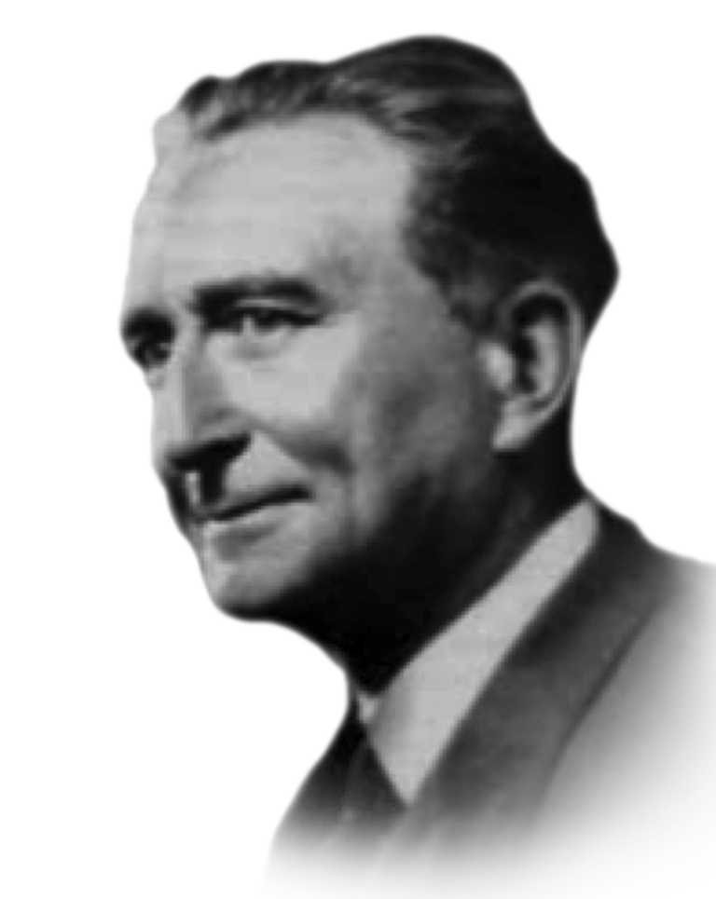
1st International conference
of social work
Paris 8/13 July 1928
Governments’ representatives of
39 countries
2,421 individuals for 42 states

Slide 4




1st International conference
of social work
During the conference were established:
Committee of Social Work Schools
(now IASSW)
International Council of Social Welfare
(ICSW)
International Permanent Secretariat
of Social Workers (now IFSW)

Slide 5
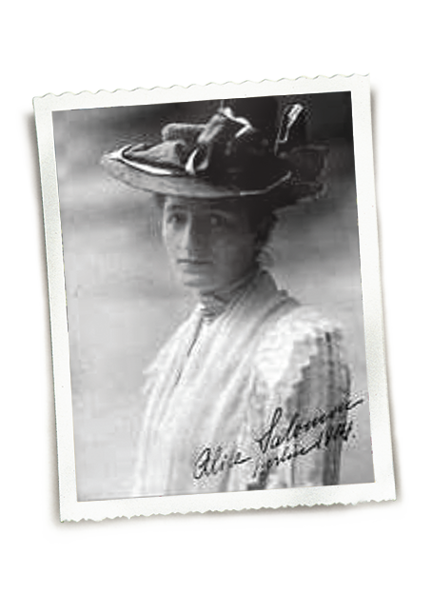
Formal constitution of the committee
ALICE SALOMON - First President
Berlin 1929
“The object of the Committee
of Schools of Social Work
is to bring about an exchange
of opinion and experience between schools of social work and to deal with all problems of international co-operation of these schools,
such as the exchange
of teachers and students,
the organization of a centre
of documentation and information, the formation of international
social study courses and the participation in the preparation
of international congresses
for social work”.

Slide 6
Alice Salomon
(1928-1946) Presidency
Membership increase
  75 schools from 18 countries
  in 1939
International conferences
  Frankfurt (1932)
  London (1936)
Documentation center on social work training
  collecting and cataloguing the materials of more than 100 schools
Comparative study
to assess common aspects of and differences in social work education

Slide 7
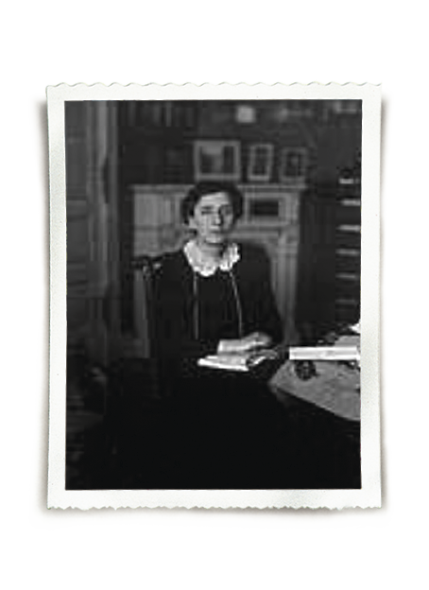
Alice Salomon
(1928-1946) Presidency
SOCIAL INJUSTICE
is a consequence of an unjust economic system that operates worldwide and therefore needs to be faced at the global level
SOCIAL WORKERS
need to have an idealistic social conscience that acknowledges the
interdependence of human beings, fights against the philosophy of individualism

Slide 8
René Sand
(1946-1953) Presidency
Restored the vitality of the organization, rebuilding the bonds broken during the 2nd world war.
Conference
in Paris 1950
Collaboration as a Non-Governmental Organization (NGO) by the United Nations (UN)
with consultative status within
the Economic
and Social Council (ECOSOC).
Fundamental role of Katherine Kendall
UN resolution identifying social work as a profession
that needed specific training and support
to develop social work education
in newly independent nations in Asia and Africa.
Conference
in Madras,
India in 1952

Slide 9
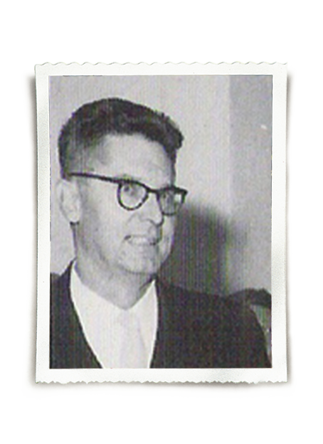
Jan Floris De Jongh
(1954-1961) Presidency
First time a team that represented both Europe and North America:
Jan de Jongh from the Netherlands in the role of President
In 1956, there was a change in the name of the organization becoming the current International Association of Schools of Social Work
In 1958, in collaboration with the ICSW, the International Social Work Journal was established and 1959, IFSW joined this initiative
Eileen Younghusband from England as Vice President
Harles Hendry from Canada as Treasurer
Katherine Kendall from America as Secretary
Increasing international compositiion both in the members and in the board.
Conferences in 1958, in Japan, in 1960 Italy, 1962 in Brazil and 1974 in Kenya

Slide 10
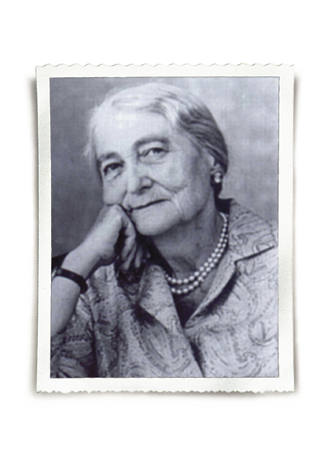
Eilen Younghusband
(1961-1968) Presidency
Contribution to founding regional associations in Africa and Latin America
Support the development and qualification of training courses in different parts of the world
More global concept of social work

Slide 11

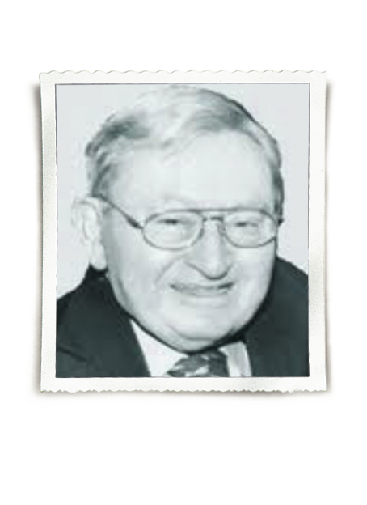
Erman Stein
(1968-1976) Presidency
Long collaboration with UNICEF
5-year contract with the United States Agency
for International Development, to create
and implement an international training project
in "family planning services"
Training and curriculum development activities
were organized in Asia, Africa, Latin America
and the Caribbean

Slide 12
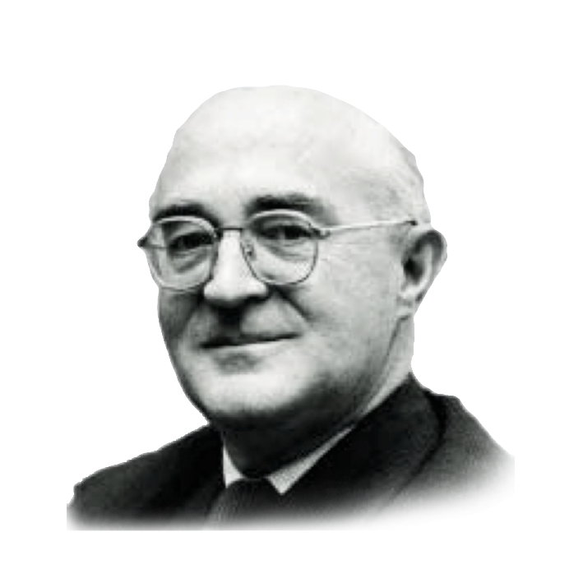
Robin Huws Jones
(1976-1980) Presidency
Beginning of the political problems for
the inclusion in IASSW of South Africa schools
where apartheid was practiced
Secretariat moved to Vienna in 1978
Linking the work of the IASSW to the mission of
the United Nations Department of Humanitarian
and Social Affairs that had been relocated from
New York to the newly established
United Nations office in Vienna

Slide 13
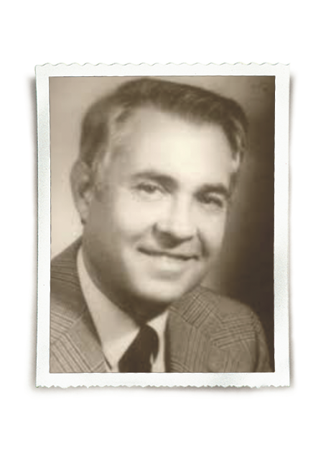
Heinrich Schiller
(1980-1988) Presidency
Ongoing political problems to the organization, due to apartheid in South Africa
Exodus of Scandinavian schools
Agreement reached with IFSW to jointly sponsor the international conferences in 1982 (Brighton), 1984 (Montreal), and 1986 (Tokyo), dissolved which resulted in the 1988 Congress in Vienna organized only by IASSW
Contacts with the Soviet Union were re-established
Dialogue was activated with Czechoslovakia, Poland
and Hungary, with the aim of revitalizing social work training
Creation of Women Interest group
World Guide to Social Work Education

Slide 14

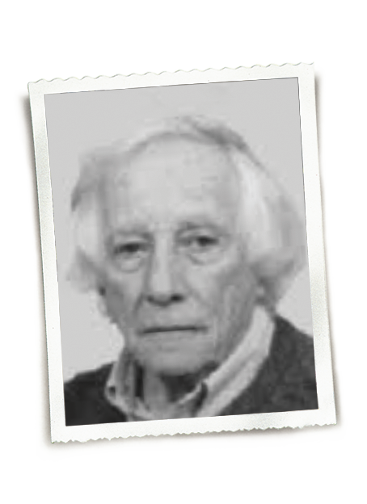
Ralph Garber
(1988-1996) Presidency
IASSW was accepted as a consultative
member by The United Nations Educational,
Scientific and Cultural Organization (UNESCO)
Tensions and conflicts with the Scandinavian
group were resolved, primarily thanks to the fall
of apartheid in South Africa
A World Census of Social Work Training Programs,
located at the university level, was initiated

Slide 15
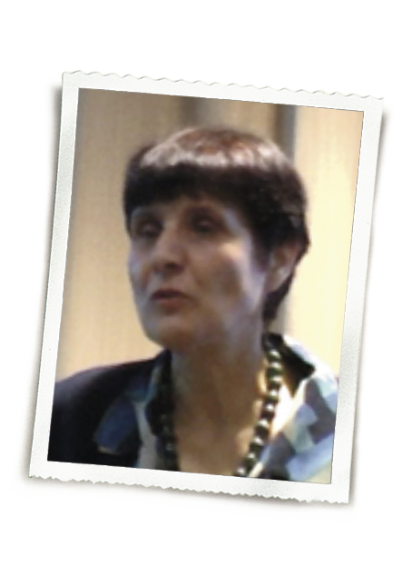

Lena Dominelli
(1996-2004) Presidency
Mission of the association was redefined, reinforcing and specifying what was established in 1929.
Resumption of dialogue with IFSW, which led to the approval of three fundamental documents: the Definition of Social Work in 2000, the Global Standards for Social Work Education and Training (2004) and the Guidelines in the Field of Ethics (2004)
Long-term response to assist social workers struggling in communities affected by disasters was developed.

Slide 16
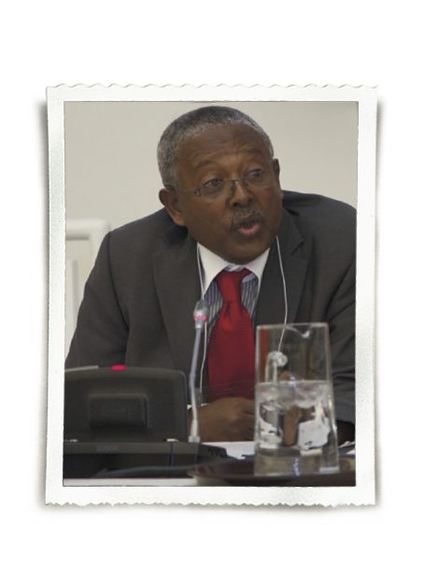
Abye Tasse
(2004-2008) Presidency
First non-American, non-European President
Development of innovative model to revitalize social work education in Ethiopia
A task group concerned with language policy was established
The presence of the association within the United Nations was strengthened
Discussion on the Global Definition of Social Work was reactivated
Alliance was sought between IFSW and ICSW to organise joint biannual global conferences
Global Agenda process was initiated

Slide 17
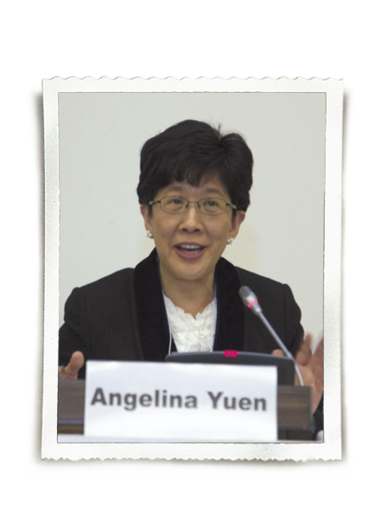
Angie Yuen
(2008-2012) Presidency
Global Agenda was launched in 2010 during
the international conference in Hong Kong
Social Dialogue Magazine was established
Innovation, in the internal organization of the
EC work, in the development of more effective
methods of communication between the members
and the outside world
First President from Asia, expression of the
development of social work training in China and full participation in IASSW of the Chinese schools.

Slide 18
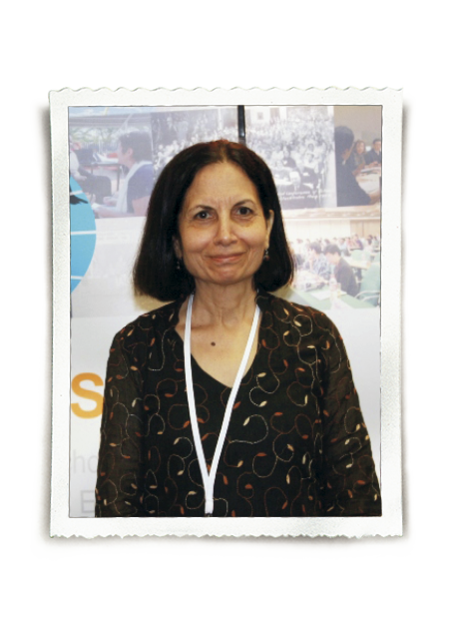
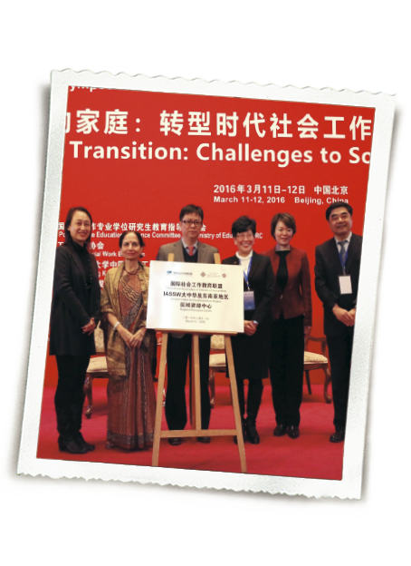
Vimla Nadkarni
(2012-2016) Presidency
A resource center in Beijing was opened
Program consultations in Sri Lanka and United Arab Emirates were realised
Capacity building activities in Vietnam were initiated
A statement was drafted on Social Work Research
Partnership with UNAIDS resulted in a book publication
The relationship with the UN in Geneva was activated with the participation of IASSW representatives and the organization of World Social Work Day

Slide 19

LOOKING
FORWARD
IASSW vision
“develop excellence in social work education,
research and scholarship across the globe, in pursuit
of a more just and equitable world”

Slide 20

LOOKING FORWARD
Future challenges

Slide 21


Languages
and the power of language
LOOKING
FORWARD

Slide 22
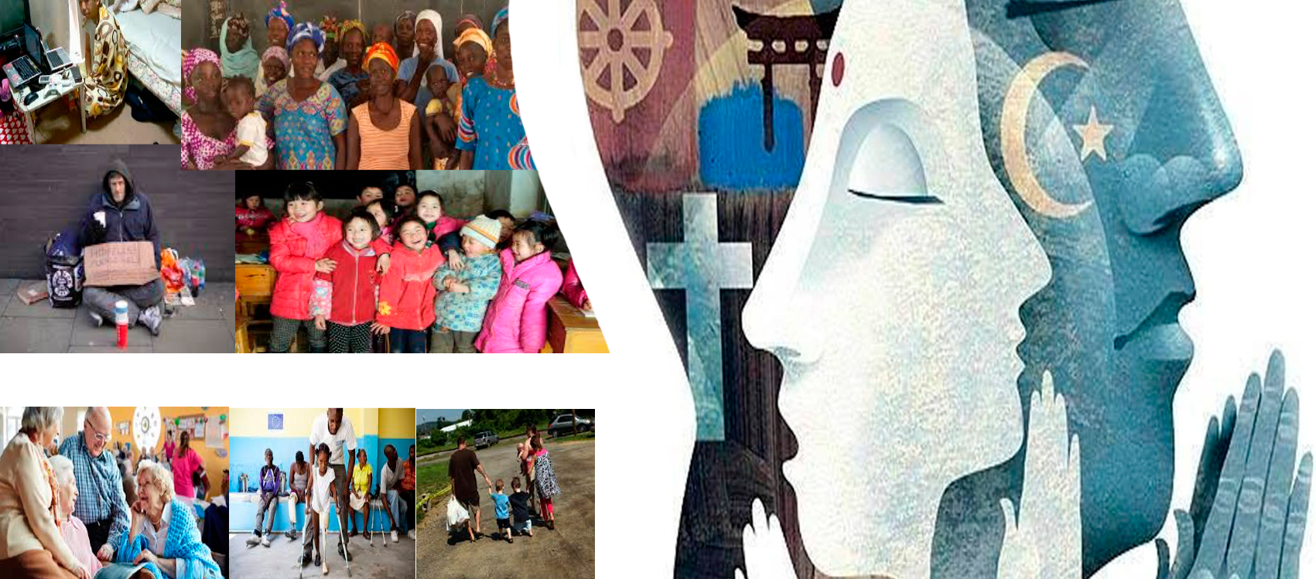
LOOKING
FORWARD
Internationalization vs Indigenization

Slide 23

LOOKING
FORWARD
Structural intervention
vs
Casework

Slide 24
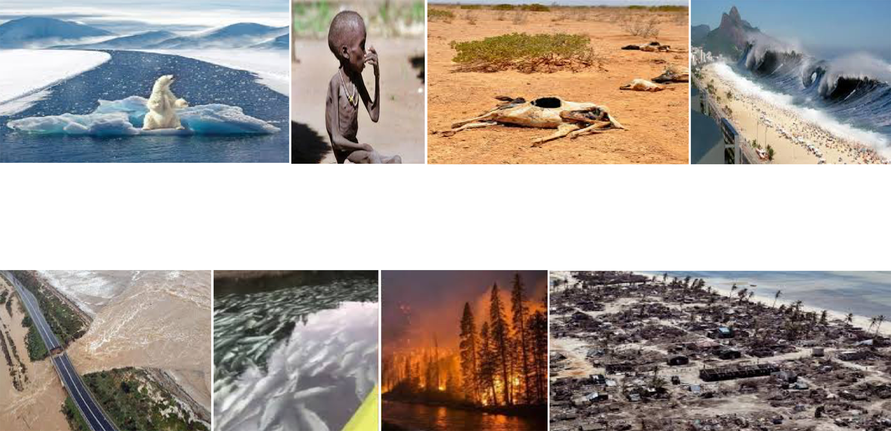
LOOKING FORWARD
Environmental Justice

Slide 25

LOOKING FORWARD
Global Agenda
2020/2030

Slide 26

LOOKING FORWARD
Social work education and Sustainable Development Goals

Slide 27

Thanks for your attention

Slide 28



