Slide 1

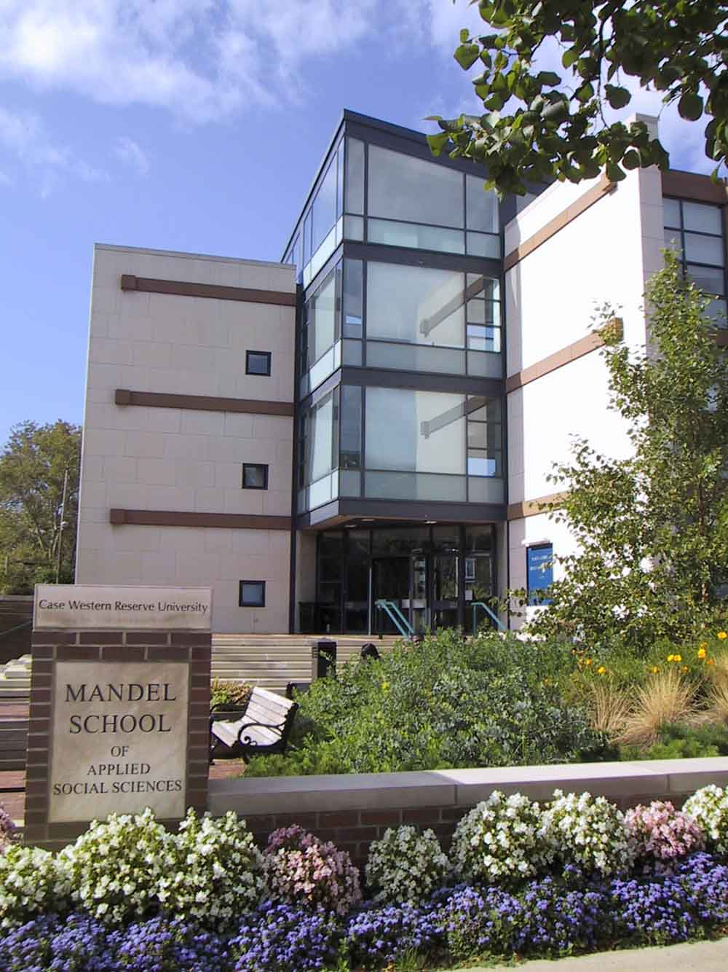


Building the Culture of Assessment: Triangulating the Process
Zoe Breen Wood, MSW, PhD
Director of Educational Outcome Assessment
Marjorie Edguer, LISW-S
Lecturer

Slide 2

Building the Culture of Assessment Creating the Map
Explicit Curriculum
Special Projects
Implicit Curriculum

Slide 3

Building the Culture of Assessment Faculty Engagement
Explicit Curriculum
Implicit Curriculum
Curriculum Committee / Outcomes Subcommittee
Developing Specialized Competencies & Dimensions
Alignment Tables
Identifying Assignments
Developing and Embedding Rubrics & Specialized Assessments
Setting Benchmarks
Revisions to Course Evaluations
Graduating Student Surveys
Specialized surveys
Deans forums / other focus groups

Slide 4

Building the Culture of Assessment Student Engagement
Orientation
Alignment Tables
Field Learning Contract

Slide 5
Building the Culture of Assessment Field Education Engagement
Revisions to Learning Contract
Surveys of field instructors and sites
Field instructor training and Support

Slide 6
Building the Culture of Assessment Making the Trip
Filling in the map – the devil is in the details.
Multiple formats
Strategies for data collection
Multiple LMSs
Multiple data sources

Slide 7
Mid Course Corrections
Setting realistic destinations
Leadership Portfolios
Developing new learning experiences
Refining and Revising

Slide 8
Are we there yet?
Using the data to drive decision making
Short term course corrections
Creating new content
Modifying assignments
Long term
Curricular revision
Innovation

