Slide 1
Health Disparities, Health Equity, and Social Justice in Integrated Behavioral Health Care
Module 5
Roseanna McCleary, PhD
California State University, Bakersfield

Slide 2
Learning Objectives
Increase knowledge of health disparities and health equity and the context in which they exist
Develop an understanding of the role of addressing health disparities in integrated behavioral care
Explore ways to address health disparities and promote health equity in integrated behavioral care models

Slide 3
Who deals with health disparity issues in the US?
National Institute of Minority Health and Health Disparities (NIH)
Office of Minority Health (DHHS)
Federal Collaboration on Health Disparities Research (DHHS)
Office of Minority Health and Health Disparities (CDC)
Office of Behavioral Health Equity (SAMHSA)
Office of Health Equity (HRSA)
Notes:
Why so many agencies at the federal level? How are each unique? Do they talk to each other?

Slide 4
Definitions
How “health disparity” and “health equity” are defined affects how a policy is conceptualized
For policy purposes, need to distinguish among:
Disparities in health
Disparities in health care
Health equity
Health inequalities

Slide 5
Definition: Disparities in Health
“Differences in the incidence, mortality, and burden of disease and other adverse health conditions that exist among special population groups in the United States”¹
“Differences in health that are not only unnecessary and avoidable, but, in addition, are considered unfair and unjust”²
Notes:
Additional:
“Differences in health outcomes that are closely linked with social, economic, and environmental disadvantage” (US DHHS, p. 1, HHS Plan to Reduce Racial and Ethnic Health Disparities)

Slide 6
Definitions: Disparities in Health Care
“Differences in the quality of health care that are not due to access-related factors or clinical needs, preferences, or appropriateness of intervention.”³
Should policymakers focus on disparities in health or disparities in health care?⁴
Notes:
See Smedley: Health Education & Behavior, 2006, 33(4)
“racial and ethnic disparities in health status are primarily a reflection of inequality in US society and that it is this inequality—in housing, education, employment, and in broader social, political, and economic arrangements that marginalize and disenfranchise people of color—that is the most significant sources of health status disparities.” (p. 539)

Slide 7
Defining “Health Equity”
“Equity in health implies that ideally everyone should have a fair opportunity to attain their full health potential . . . No one should be disadvantaged from achieving this potential”⁵
Equity in health care requires that resource allocation and access to health care be determined by health needs” ⁶
Notes:
Equity as access, availability of resources
Others define health equity using concepts such as “horizontal equity” (equal treatment for equal need) and “vertical equity” (different treatment for different need) (Mooney, 1987)
Culyer & Wagstaff (1993) looked at four definitions of health care equity – equal utilization, distribution according to need, equal access, and equal health outcomes.
Health equity is achieved by eliminating health disparities
Healthy People 2020 notes that the progression in goals from 2000 on – to reduce health disparities, to eliminate health disparities, and now in 2020, to achieve health equity, eliminate disparities, and improve the health of all groups.
“Attainment of the highest level of health for all people. Achieving health equity requires valuing everyone equally with focused and ongoing societal efforts to address avoidable inequalities, historical and contemporary injustices, and the elimination of health and health care disparities.” (Healthy People 2020, 2010)

Slide 8
Why is it Important to Define These Terms?
Should mental and substance use disorders treatments be integrated into general health policy?
E.g., Mental Health and Substance Abuse Parity
Or should they be treated as exceptions?
E.g., carve-outs?
Which of the previous definitions best reflects a social justice perspective?
Notes:
IOM definition (Unequal Treatment): any inequality in health due to social factors or allocation of resources is unjust and, therefore, constitutes a disparity (e.g., health status differences due to higher rates of poverty, such as poor nutrition (from Miranda et al., Am J Psychiatry 165:9, 2008

Slide 9
The Face of Health Disparities: Brianna
Brianna is a 9 year old African-American female who is admitted to the pediatrics unit for respiratory failure related to undiagnosed asthma
Brianna receives almost all of her medical care from emergency room and urgent care visits
She lives at home with her mother and 2 siblings
Brianna’s mom works as a clerk at a construction company and earns $29,232 a year; she cannot afford to pay for the additional health insurance fees for her 3 children and has become increasingly depressed due to numerous stressors
Notes:
Adapted from: http://www.advocacyoncall.org/docs/CaseStudy_HealthDisparities.pdf
Rate of asthma among this population: prevalence of asthma is higher in minority and low income populations; low income, minority children have the greatest morbidity from asthma

Slide 10
The Face of Health Disparities: Maria
Maria, 81, recently had a stroke and also has diabetes and high blood pressure; she relies on a wheelchair, and needs help with her activities of daily living
Maria came to the US when she was in her 20’s from the Mexican state of Oaxaca and worked in agriculture until she retired at age 65
She relies on her family for her care, however, when one of her daughters lost her job, Maria had to use what little savings she had to cover costs
Her family doesn't know how they will continue to pay for and manage Maria’s care
Notes:
Older adults face different issues that other populations
Need to use a life span approach to understand health disparity issues

Slide 11
Health Disparities: The Context
Health disparities are connected to a social context that includes individual, socioeconomic, and political factors which determine health outcomes⁷
Historically social policy has contributed to health disparities
Factors may include housing, neighborhood, access to work and educational opportunities, individual lifestyle (age, gender), socioeconomic status, and access to health care
Evidence shows that health disparities among particular racial and ethnic groups have multiple causes that need to be addressed on multiple levels
Describe Brianna’s and Maria’s contexts and how they have lead to health disparities
Notes:
Clip from Unnatural Causes related to effects of a river damming on indigenous culture
“Research efforts should reflect a more sophisticated understanding of the role of social and behavioral determinants of health) Smedley, p. 540

Slide 12
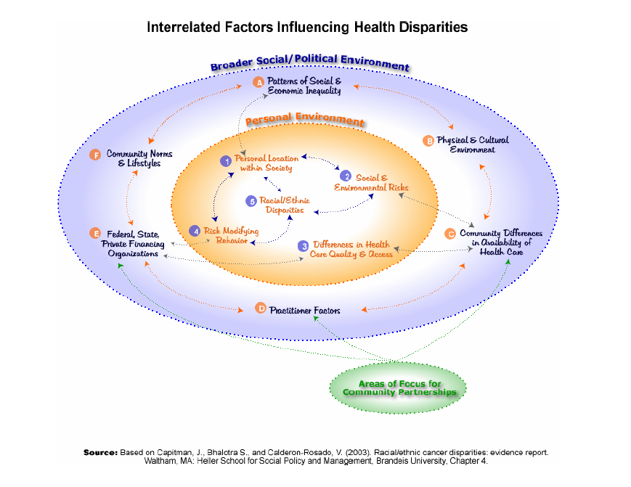
Notes:
One way to visualize the complexity of dealing with health disparities (complex systems) and why a multilevel, integrated behavioral health approach is necessary to address this complexity
Apply this model to Brianna and Maria’s situations

Slide 13
Examples of Health Disparities in Mental Health
Children from racial/ethnic minority groups are 1/3 to 1/2 less likely to receive necessary mental health treatment than White children, despite similar prevalence rates⁸
Only 1 in 11 Latinos with a mental health disorder contacts a mental health provider and 1 in 5 contacts a general health care provider⁹
LGBT adults have higher rates of smoking, alcohol and drug use, suicide, and depression¹⁰
Notes:
Other examples:
System access barriers for American Indians due to underfunding of the Indian Health Service’s mental health programs (Colorado Trust)
Non-Hispanic Blacks who were treated for substance abuse were significantly less likely than non-Hispanic Whites to complete treatment

Slide 14
More Examples of Health Disparities in Mental Health
Hispanic Americans (except those from Puerto Rico), Asian Americans, and Black Americans have a lower incidence of mental disorders than White Americans
The Latino or Hispanic paradox – Hispanic populations have lower rates of illness, but the more time someone from Mexico, Africa, or the Caribbean spend in the US, the higher the rate of disorders
American Indians are at higher risk for PTSD and alcohol dependence, but at lower risk for depression¹¹
Notes:
Link to a short clip from trailer “Unnatural Causes” that discusses the Latino paradox
Disparities are found in access, use, and quality of care – very little progress has been made to reduce these disparities in MH care

Slide 15
How Do We Measure Health Disparity?¹²
Life expectancy, infant mortality, rate of chronic diseases – differences among ethnicities
Health care – what is recommended and what is available or delivered
Access to care – barriers
Geographic and provider-level differences
Availability of culturally-sensitive, trained, bilingual mental health professionals
Notes:
These measures can provide evidence for the need for specific policies and approaches

Slide 16
Causes of Disparities in Mental Health and Substance Use Disorders
Lack of insurance
Geographic and provider-level differences
Poor access
Low quality of care
Health provider assumptions, discrimination
Language barriers
Mental health workforce disparities
Notes:
Research has shown that all of these factors may have an effect, however, more multilevel, multicausal studies need to be done

Slide 17
Approaches to Reduce or Eliminate Health/Health Care Disparities
Address social disparities (e.g., poor housing, low education, poverty, lack of job opportunities)
Improve access to care
Provide incentives to health care professionals for improving communication, providing appropriate screening and treatment
Increase racial and ethnic diversity in the mental health care workforce to reflect community populations
Notes:
All of these can be addressed in an integrated care program; all of these need more of an evidence base

Slide 18
An Example of an Integrated Model of Care Addressing Health Disparities
An organization that addresses health disparities is:
“Culturally and linguistically competent,
Responsive to the community,
Resides in a reasonable location,
Has flexible hours of operation”, and
“Committed to addressing social determinants of health disparities” (e.g., health literacy, socioeconomic status, housing)
See handout for schema¹⁴
Notes:
One model/framework for dealing with some aspects of health disparity within an integrated model

Slide 19
Equity in Mental and Substance Use Disorders Health Care Policy
Mental Health Parity Act of 1996
9 USC § 1185a - Parity in mental health and substance use disorder benefits
Olmstead v. L.C, 527 U.S. 581 (1999)
People have a right to live in the community in the least restrictive environment
Paul Wellstone and Pete Domenici Mental Health Parity and Addiction Equity Act of 2008
Expanded MHPA to include substance abuse treatment
Pending in Congress
S. 2474: Health Equity and Accountability Act of 2012 introduced by Senator Akaka
Notes:
From: http://www.samhsa.gov/healthreform/parity/
This new Federal law requires group health insurance plans (those with more than 50 insured employees) that offer coverage for mental illness and substance use disorders to provide those benefits in no more restrictive way than all other medical and surgical procedures covered by the plan. The Mental Health Parity and Addiction Equity Act does not require group health plans to cover mental health (MH) and substance use disorder (SUD) benefits but, when plans do cover these benefits, MH and SUD benefits must be covered at levels that are no lower and with treatment limitations that are no more restrictive than would be the case for the other medical and surgical benefits offered by the plan.
MHPAEA, which amended the Public Health Service Act, the Employee Retirement Income Security Act (ERISA) and the Internal Revenue Code, generally is effective for plan years beginning on or after October 3, 2009. (http://www.dol.gov/ebsa/newsroom/fsmhpaea.html)
In 2009, the Civil Rights Division launched an aggressive effort to enforce the Supreme Court's decision in Olmstead v. L.C., a ruling that requires states to eliminate unnecessary segregation of persons with disabilities and to ensure that persons with disabilities receive services in the most integrated setting appropriate to their needs. President Obama issued a proclamation launching the "Year of Community Living," and has directed the Administration to redouble enforcement efforts. The Division has responded by working with state and local governments officials, disability rights groups and attorneys around the country, and with representatives of the Department of Health and Human Services, to fashion an effective, nationwide program to enforce the integration mandate of the Department's regulation implementing title II of the ADA. (from http://www.ada.gov/olmstead/index.htm)

Slide 20
Health Disparities and the Patient Protection and Affordable Care Act
There are numerous provisions in the PPACA that address reducing health disparities and increasing health care equity
These fall under six domains:
Consistent data collection
Workforce diversity
Cultural competence training and education
Funding health disparities research
Prevention program promotion
Addressing disparities in health insurance reform

Slide 21
PPACA and Integration
ACA has a number of provisions to integrate primary and behavioral health care
SAMHSA states that:
“For consumers of mental health services or those in recovery from addiction disorders, the law’s provisions and the general movement toward integration are important steps that can lead to improved overall health”¹³
How do the 6 domains address health disparities and how can they be incorporated into integrated care models?
Discussion: How does your county mental health and public health agencies address these 6 domains, and what models of integrated behavioral health care are being implemented?

Slide 22
Achieving Health Equity for All – an Organizational Model for Change
How does an agency address health disparity issues and ensure that those it serves gets equitable health care?
Key step is an organizational self assessment to determine which issues need to be addressed, the organization’s ability to address these issues, and its readiness to implement changes
The Bay Area Regional Health Inequities Initiative (BARHII) toolkit for organizational self-assessment is one collaborative model that shows how one community is dealing with their health inequities¹⁴

Slide 23
BARHII Organizational Assessment –Organizational Characteristics and Workforce Competencies¹⁵
Organizational Characteristics
Workforce Competencies
Institution/agency’s commitment to addressing health inequities
Willingness to hire
A structure that will support collaborations/partnerships
Staff support
Transparent communication
Creative use of categorical funds
Community-accessible data and planning
A smooth administrative process
Passion, self-reflection, and listening skills
Knowledge of a public health framework
Able to integrate social, environmental, and structural determinants of health
Knowledge of the community/Leadership skills
Ability to collaborate/Community organizing skills
Problem solving skills/Cultural sensitivity

Slide 24
Additional Models for Organizational Self Assessment
National Center for Cultural Competence, Innovative self assessment and strategic planning - focus on cultural and linguistic competence (http://nccc.georgetown.edu/documents/Contra%20Costa.pdf)
State of New Jersey, Department of Health and Human Services Health Disparities Self Assessment (http://www.state.nj.us/health/omh/documents/2009self_assessment_survey_report.pdf)
Developing a Self Assessment Tool for CLAS in Local Public Health Agencies (http://www.minorityhealth.hhs.gov/assets/pdf/checked/LPHAs_FinalReport.pdf)

Slide 25
Health Equity Beyond Race and Ethnicity
Disparities exist in other populations
Older adults
Higher rates of suicide
The LGBT community (in particular, older adults)
Access to health care
Higher rates of smoking, alcohol and drug use, suicide and depression
Persons who live in rural areas
Lack of healthcare professionals, specialists
High poverty levels
Notes:
Focus has been on race and ethnicity, however, there are equity issues among other populations

Slide 26
Implications for Social Work
Culturally sensitive practice is crucial when dealing with health disparities
Awareness of the causes of health disparities is needed in order to advocate for vulnerable populations
By dealing with health disparities, the goal of health equity can be realized

Slide 27
References
National Institutes of Health. (2009). Biennial Report of the Director. Retrieved from http://report.nih.gov/biennialreport/ViewSection.aspx?sid=26&cid=4
Whitehead, M. (1992). The concepts and principles of equity and health. International Journal of Health Services, 22, 429-445.
Stith AY, Nelson AR. (2002). Committee on Understanding and Eliminating Racial and Ethnic Disparities in Health Care, Board on Health Policy. Institute of Medicine. Washington, DC: National Academy Press.
Smedley, B.D. (2006). Expanding the frame of understanding health disparities: from a focus on health systems to social and economic systems. Health Education and Behavior, 33(4):538-41.
Whitehead, M. (1992). The concepts and principles of equity and health. International Journal of Health Services, 22, 429-445.
Aday, LA, Fleming, GV, Anderson, RM. (1984). An overview of current access issues. In Anderson, R. and Aday, LA. Access to medical care in the US (pp. 1-18). Chilcago, IL: Pluribus Press/University of Chicago.
Stratton, A., Hynes, M., Nepaul, A. (2007). Issue brief: Defining health disparities. The Connecticut Health Disparities Project. Connecticut Department of Public Health. Retrieved from http://www.ct.gov/dph/lib/dph/hisr/pdf/defining_health_disparities.pdf
National Institute of Allergy and Infectious Diseases. (2001). Minority health: What are mental disparities? Retrieved August 1, 2012 from http://www.niaid.nih.gov/topics/minorityhealth/pages/disparities.aspx
National Council of La Raza, 2006
Movement Advancement Project. (2007, September). LGBT older adults and health disparities. Retrieved from http://www.lgbtmap.org/file/lgbt-older-adults-and-health-disparities.pdf
Miranda, J, McGuire, TG, Williams, DR, Wang, P. (2008). Mental health in the context of health disparities. The American Journal of Psychiatry, 165(9).
Miranda, J, McGuire, TG, Williams, DR, Wang, P. (2008). Mental health in the context of health disparities. The American Journal of Psychiatry, 165(9).
Substance Abuse and Mental Health Services Administration. (2011). Why is the Affordable Care Act important for people with health disparities? (SMA11-HR006). Rockville, MD.

Slide 28
References
14. Sanchez, K. Chapa, T., Ybarra, R., Martinez, O. N. (2012). Enhancing the delivery of health care: Eliminating health disparities through a culturally and linguistically centered integrated health care approach. Hogg Foundation for Mental Health. Retrieved from http://www.hogg.utexas.edu/uploads/documents/FinalReport%20-ConsensusStatementsRecommendations.pdf
15. Bay Area Health Inequities Initiative (2010). Organizational self assessment for addressing health inequities. Toolkit and guide to implementation. Oakland, CA; BARHII. Retrieved from: http://www.barhii.org/resources/downloads/self_assessment_toolkit.pdf.

