Slide 1

Monthly Membership Meeting
September 24, 2025, | 1 p.m. ET
Enhancing connections and benefits for all members

Slide 2

WELCOME

Slide 3

Meeting Agenda
Welcome & Introductions
Membership Program Overview
Member Benefits Highlight
Online Resources Review
Open Forum/Q&A Session
Upcoming Events/Initiatives

Slide 4


About US
Founded in 1952
Non-profit, 501c(3) organization
Members include more than 900 accredited baccalaureate, master’s and practice doctorate degree social work programs dedicated to advancing quality social work education
CSWE represents everyone who teaches at, studies or works at, or connected to social work programs

Slide 5
Our Core purpose
To ensure a well-educated social work profession equipped to advocate for and promote education, health, well-being, universal rights, and justice in a diverse world.
Our mission
To advance excellence and innovation in social work education, by providing leadership and scholarship, to ensure quality in teaching and learning, supporting critical thinking, empathy, and advocacy to strengthen the capacity of our membership.

Slide 6



2026 Strategic plan
Goal One:
Anticipate the implications and opportunities of artificial intelligence (AI) and other disruptive technologies and position the Council on Social Work Education (CSWE) to be a leader in this area on behalf of social work education and the profession of social work.
Goal Two:
Develop transformative leaders that uphold our core professional values and stand with our accredited social work education programs to effect change on behalf of society.
Goal Three:
Become increasingly accessible and responsive to the needs of CSWE’s student members.

Slide 7

Membership Program overview

Slide 8
Membership Categories
Program Membership
Institutional membership (accredited programs)
Includes current, emeritus, faculty, students, administrators, and staff of the specific program
All affiliated individuals receive CSWE member benefits
Membership dues cost is based on the program size (number of graduates from previous year’s submitted Annual Survey report)
Individual Membership
Associate membership – Available to non-CSWE members who are not members of CSWE through a program’s institutional membership.
Eligibility - Ideal for those connected to social welfare agencies (national, state, local)
Open to professional social work association members
Field instructors with educational duties in social work programs
Retired social work education professionals
Membership dues $199.00/year

Slide 9

Member benefits
Professional Participation
Discounted member rate to attend, exhibit, submit proposals, or sponsor CSWE’s Annual Conference
Inclusion in and access to the CSWE Program Member Directory and the CSWE Individual Member Directory
Opportunities to volunteer for service as a commission or council member, an accreditation site visitor, or an Annual Conference abstract reviewer
Leadership development opportunities through CSWE’s committees and task forces
Professional Identity and Advocacy
Strengthening the voice of social work education through our advocacy and policy work
Contribute to the advancement of the profession through CSWE’s Public Policy Initiative

Slide 10
Member benefits
Professional Discounts
Significant savings on registration fees for CSWE events
Discounts on CSWE Press publications and resources, including 10% off purchases from CSWE’s bookstore
Access to Professional Resources
The Journal of Social Work Education (JSWE)
CSWE's online resource library
CSWE SPARK, the virtual community platform for social work educators, students, practitioners, and more.
CSWE Compass, CSWE's weekly newsletter that includes important news, member resources, upcoming events, educational opportunities, advocacy updates, job openings, and more!
Teaching resources and curriculum guides
Informative webinars
CSWE Learning Academy
Fellowship & scholarship Opportunities
Minority Fellowship Program (MFP) – Doctoral & Masters Students
Doctoral Student Policy Fellowship
Carl A. Scott Memorial Fund
CSWE Substance Use Disorders Education and Leadership Scholars Program

Slide 11
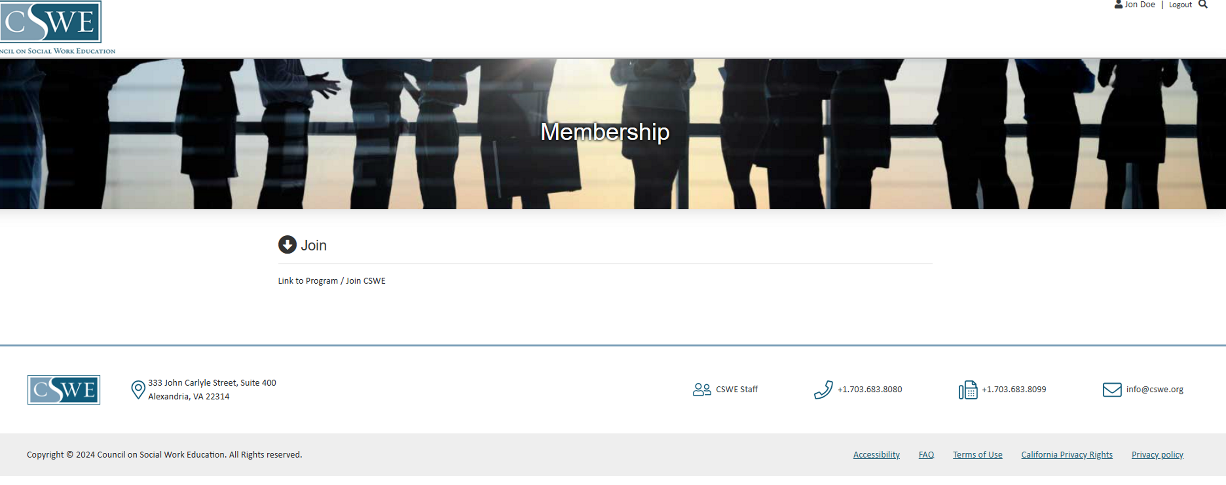
Maximize your membership experience!
Online Resources & Tools
Member Login - My Profile
Directories – Individual and Program
Education & Resources
Events

Slide 12
Cswe website Review – Online resources & tools

Slide 13
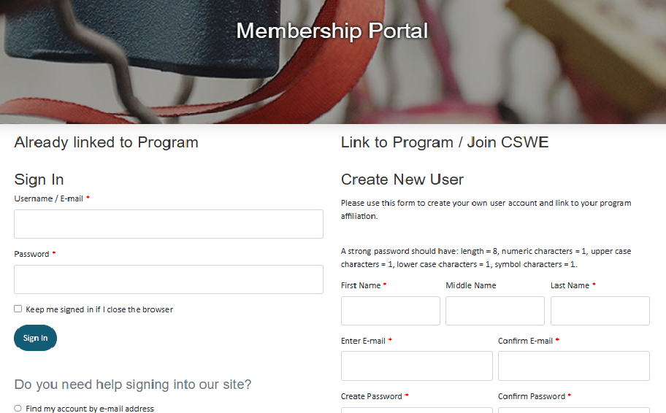
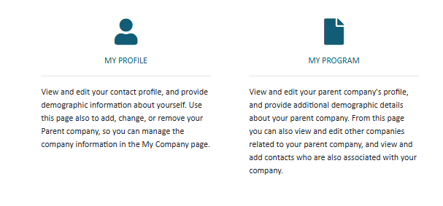
How to Access your CSWE Account
Navigate to the CSWE membership webpage and access the member login section: https://membership.cswe.org/My-Account/My-Membership
Under the Sign In section, enter your username and password
Username is your current email address you entered when you created your account
Password – if you have any issues with your password, click on “I forgot my Password” to reset your password – there is no set format for passwords (i.e.: upper lower-case letters, numbers, etc.)
Once you log into your account. Click on My Account tab to access your profile information under My Profile.
My Profile – you can view and edit your contact information, program information and provide demographic information. You can also edit and change your program information for those linked to a program
Please note for your information to be displayed in the Individual Membership Directory, you must give permission by selecting the release of your information and to include your information in the directory.

Slide 14
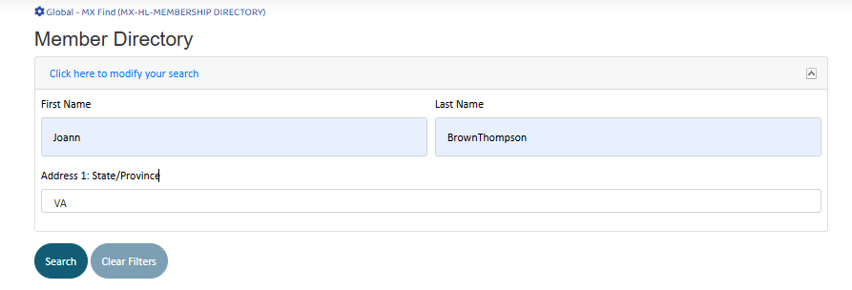
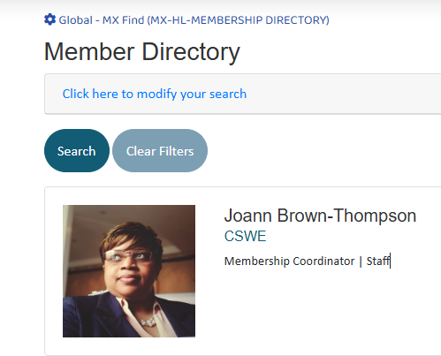
How to Access the CSWE Individual & Program Member Directory
From your member profile home page: https://membership.cswe.org/Membership
Click on the Member Directory tab
To search the directory, enter the individual’s first and last name or state to start your search. Click on the “Search” link.
Once your results are displayed, to find out more about the program the individual is linked to, just click on the name of the program.
You will then be taken to the Directory of Accredited Programs, web page, you can see more accreditation program detail from this directory
You can also access the Directory of Accredited Programs from the Accreditation web page: https://www.cswe.org/accreditation/about/directory/

Slide 15
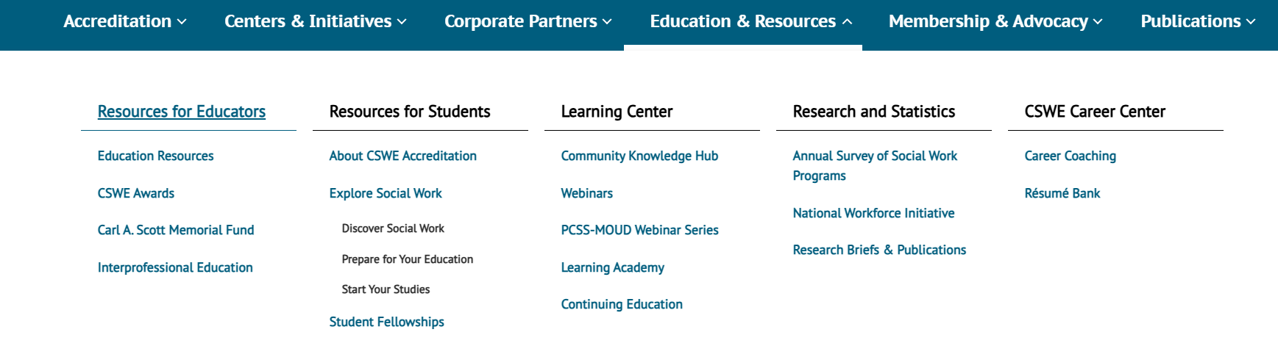
Accessing education & resources
Navigate to the CSWE home page: www.cswe.org and place your mouse pointer to the Education & Resources tab:
From this drop-down menu, you can choose a variety of topics and resources at your fingertips. From resources specific for educators and students to access to the CSWE Learning Center, Research as well as our Career Center.
Just select the links to be taken to the web pages for more detailed information and additional helpful links

Slide 16

How to access & register for the CSWE Annual Conference
You can access the Annual Conference webpage directly at: https://www.cswe.org/events-meetings/2025-annualconference/
You can also access the conference webpage by clicking on the Events link at the top of the home page.
Once you are on the conference webpage, you will see a listing of resources for this event. To register for the conference, please select the Register and Travel link: 2025 Annual Program Meeting | CSWE
The Register & Travel page also lists housing, visa and the registration category information. As well as such as the conference schedule, additional links special events and much more!
Next select the correct category of membership to log into the registration page: Member or Non-Member.
Unsure of your membership status? Be sure to make sure you have activated your membership by connecting to your social work education program before registering for the Annual Conference. You will need to be logged into our membership portal to register as a member.

Slide 17

Stay CSWE connected!
Questions about membership? Contact Joann Brown-Thompson, Membership Coordinator at membership@cswe.org or call: 703-519-2067
Email communications
Publications
Add comms@cswe.org to your safe senders list to stay updated with current news and events
Add cswe@multibriefs.com to your safe senders list so that you do not miss vital CSWE news.
Stay updated with your CSWE Compass subscription. CSWE Compass our weekly newsletter distributed every Thursday.
The Journal of Social Work Education (JSWE) is available in print and fully searchable online format by subscription
Accreditation & Education
Follow us on Social Media & Connect @ CSWE SPARK:
Email accreditation@cswe.org for any accreditation questions.
Email: education@cswe.org for any professional education questions
LinkedIn: /cswe
Facebook: /onecswe
Instagram:@onecswe
CSWE SPARK – a virtual community platform made for you!

Slide 18
Questions?

Slide 19

Upcoming events & initiatives
Upcoming Events
CSWE’s 71st Annual Conference
Denver, Colorado October 23 – 26, 2025
Webinar recordings:
PCSS-MOUD Webinar on Addiction and Veterans live session (September 23, 2025)
AI for the Human Side of Social Work: A Live Simulation Demonstration - live session (September 16, 2025)
CSWE News:
CSWE Officially Recognized to Accredit Practice Doctorate Social Work Programs

Slide 20

Thank you!
Recording and slides will be available to members within 24-48 hours after each live session on the “Monthly Meeting” tab located within your CSWE member account homepage

Slide 21
Stay CSWE connected!
Questions about membership? Contact Joann Brown-Thompson, Membership Coordinator at membership@cswe.org or call: 703-519-2067
Email communications
Publications
Add comms@cswe.org to your safe senders list to stay updated with current news and events
Add cswe@multibriefs.com to your safe senders list so that you do not miss vital CSWE news.
Stay updated with your CSWE Compass subscription. CSWE Compass our weekly newsletter distributed every Thursday.
The Journal of Social Work Education (JSWE) is available in print and fully searchable online format by subscription.
Accreditation & Education
Email accreditation@cswe.org for any accreditation questions.
Email: education@cswe.org for any professional education questions
Follow us on Social Media & Connect @ CSWE SPARK:
LinkedIn: /cswe
Facebook: /onecswe
Instagram: @onecswe
CSWE SPARK – a virtual community platform made for you!

